Slide 1
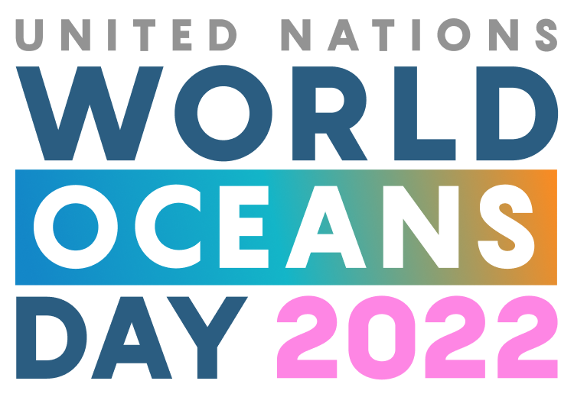

Slide 2
World Oceans Day 2022
​​”This year’s United Nations World Oceans Day, on 8 June 2022, will highlight the theme Revitalization: Collective Action for the Ocean. This is the first hybrid celebration of the annual event, hosted in-person at the UN Headquarters in New York and broadcast live.
The ocean connects, sustains, and supports us all. Yet its health is at a tipping point and so is the well-being of all that depends on it. As the past years have shown us, we need to work together to create a new balance with the ocean that no longer depletes its bounty but instead restores its vibrancy and brings it new life.”
Statements drawn from https://unworldoceansday.org/.

Slide 3
June 2 – Wealth of the Oceans

Slide 4
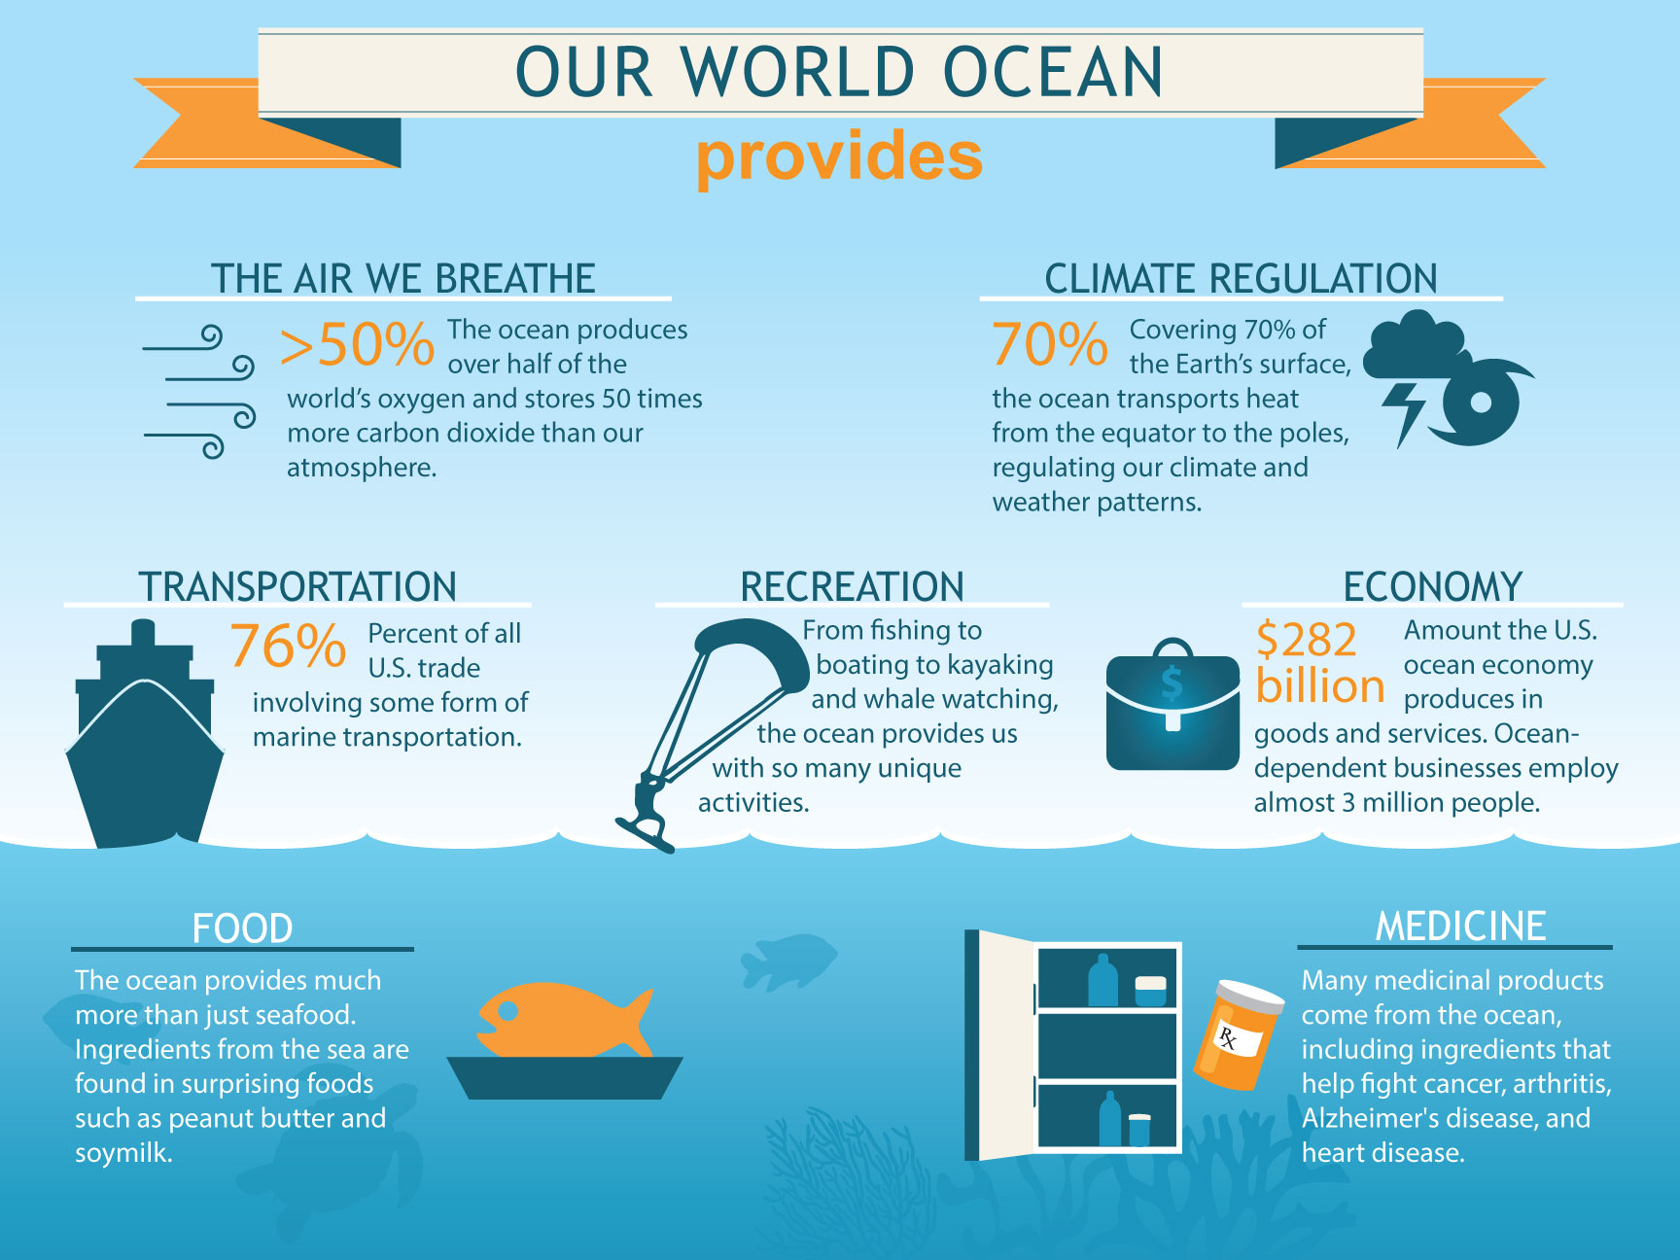
NOAA Infographic

Slide 5
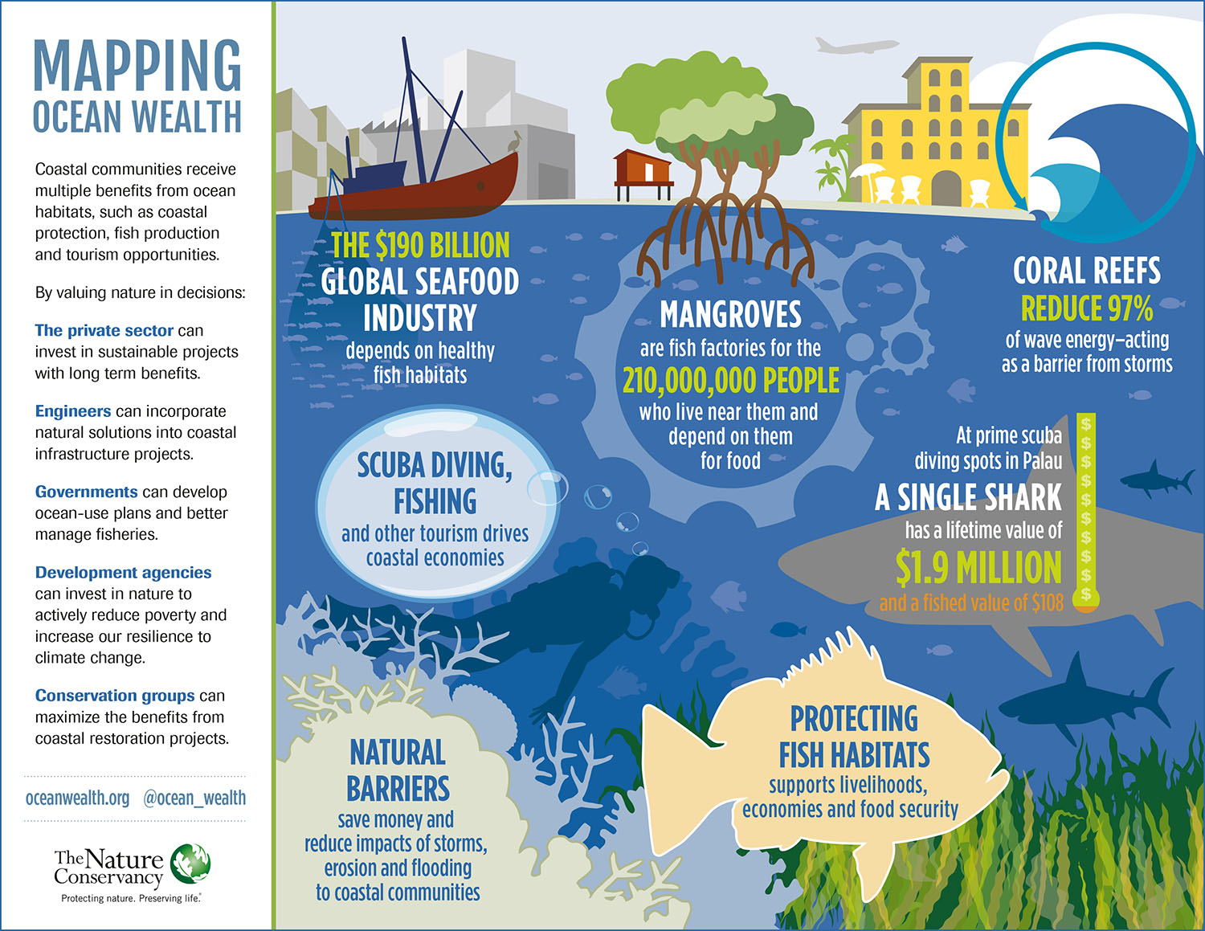

Slide 6
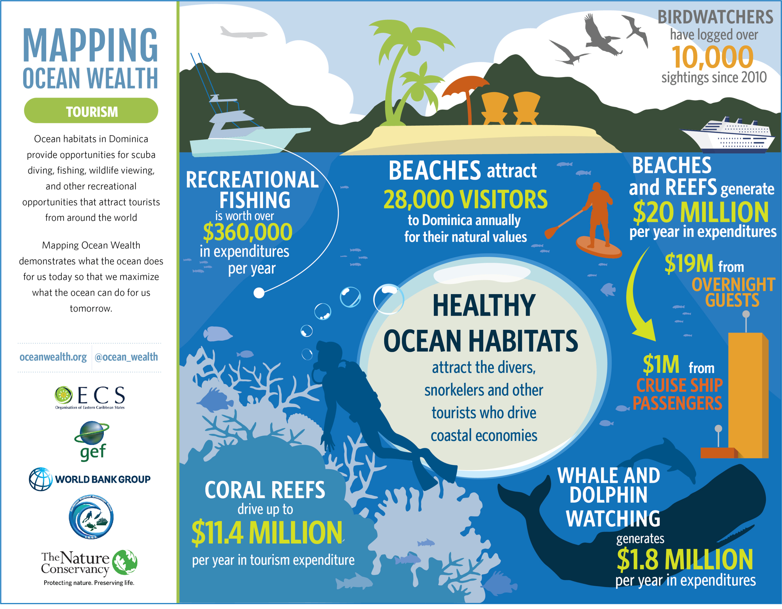

Slide 7
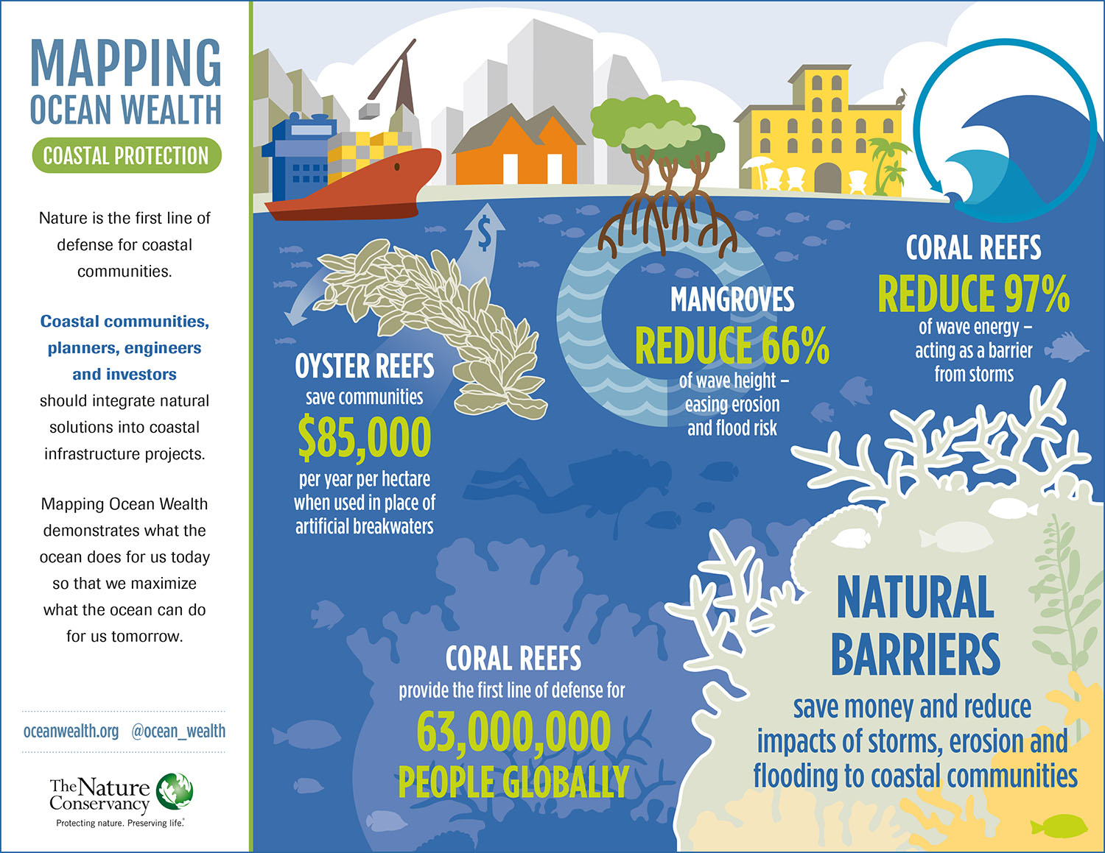

Slide 8
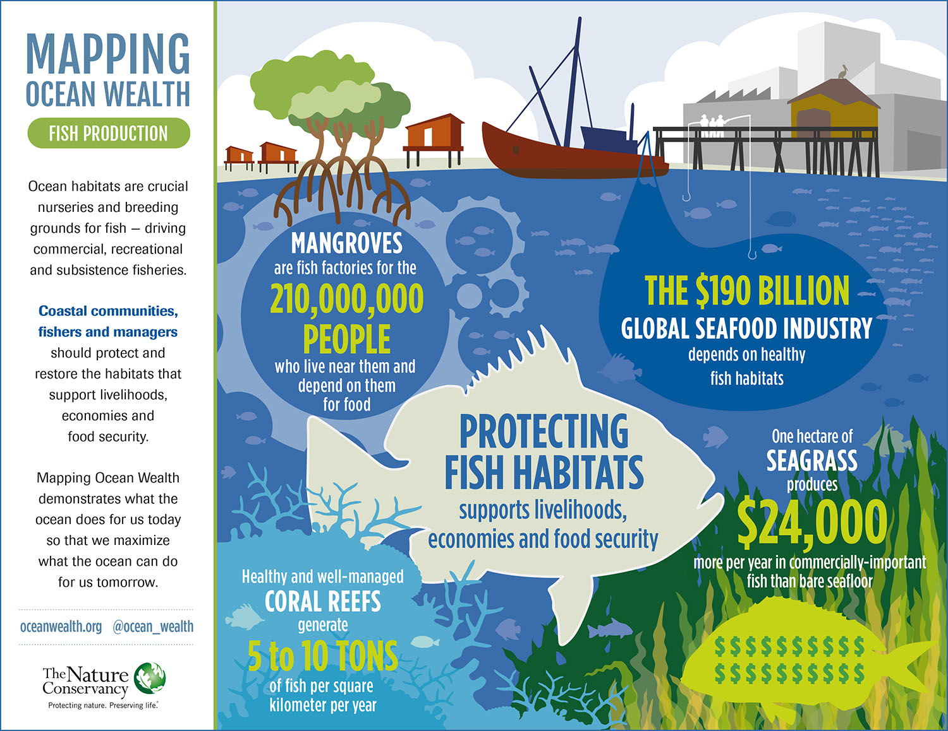

Slide 9
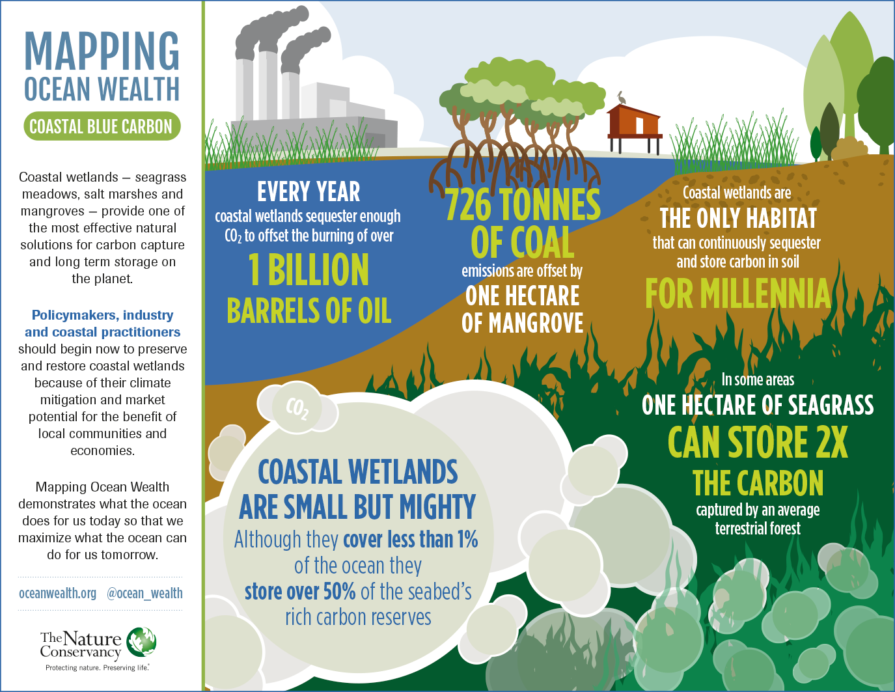

Slide 10
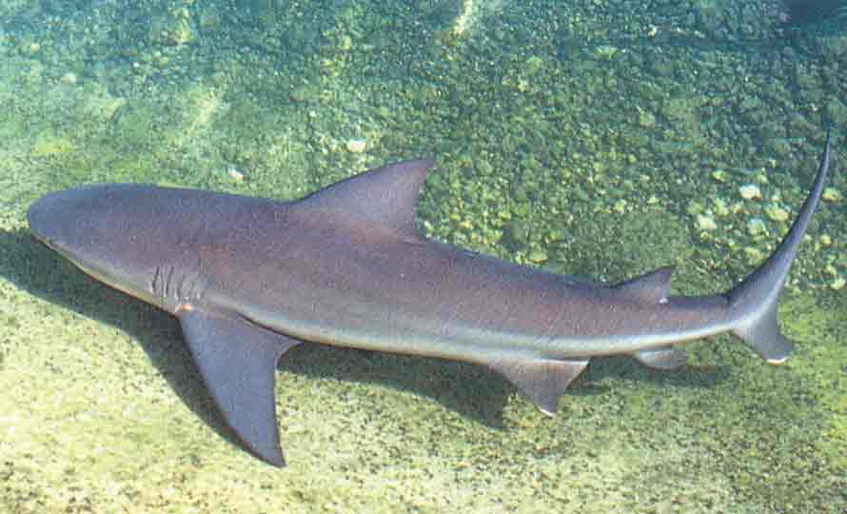
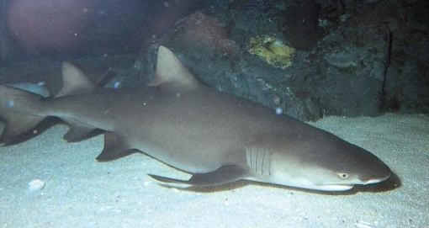
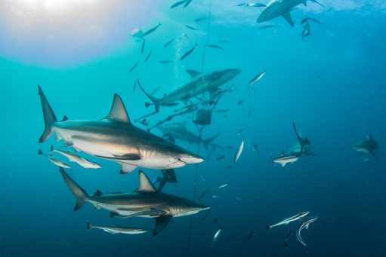
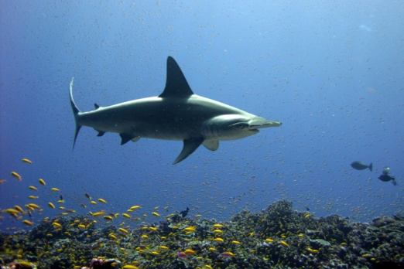
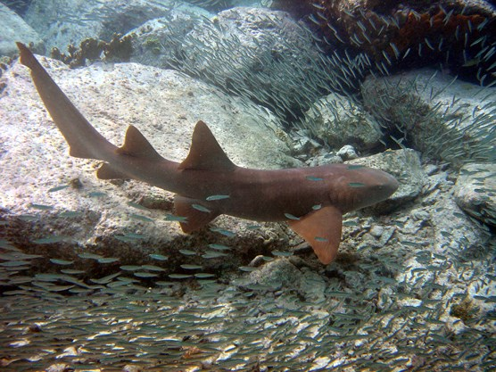
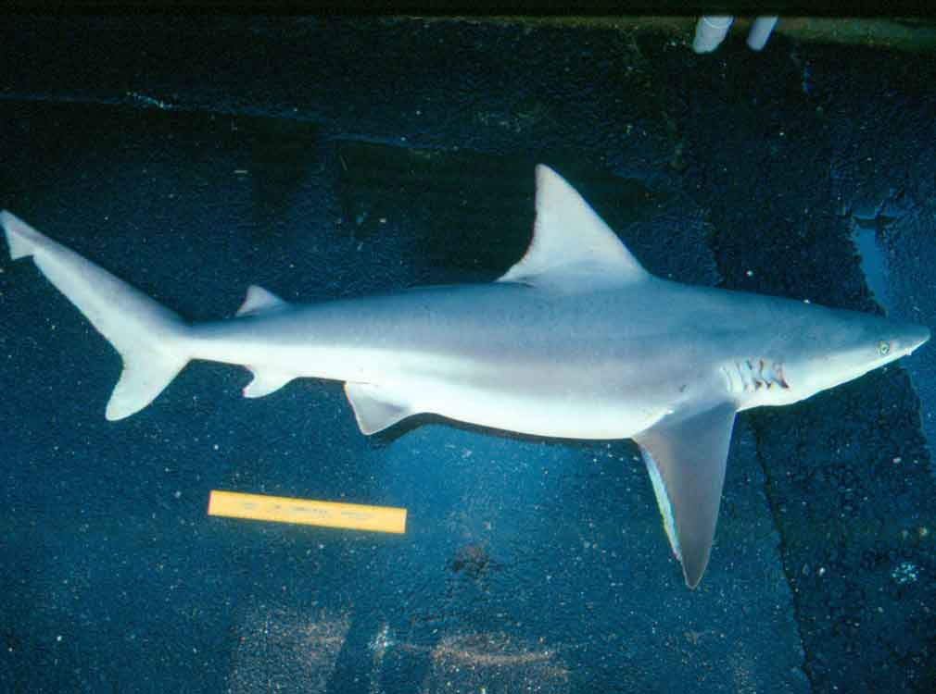
Some Sharks in the Gulf
Bull sharks can inhabit fresh water and are among the most likely to attack humans
Blacktip sharks may spin while hunting
Nurse sharks are sedentary but can still bite!
Lemon sharks inhabit coastal areas and can grow to over 10 ft
Some sharks have become endangered such as hammerheads which may die after “catch and release”
Sandbar sharks typically feed on bottom dwelling animals like crabs and octopus
NOAA Photo
NOAA Photo
NOAA Photo
NOAA Photo
NPS Caroline Rogers Photo
NOAA Photo

Slide 11
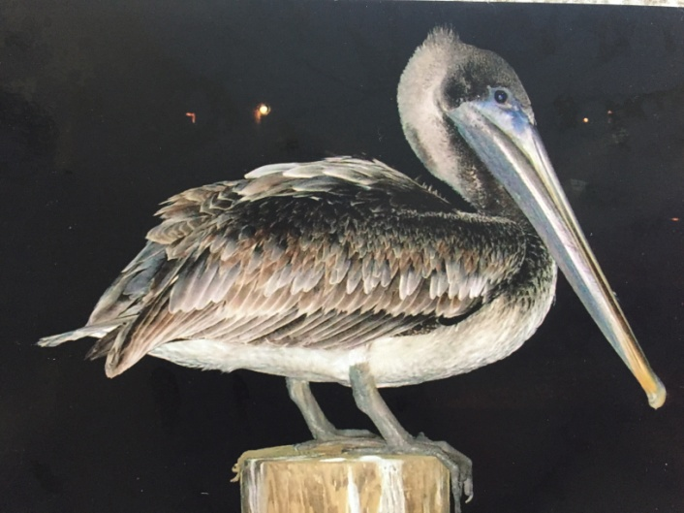
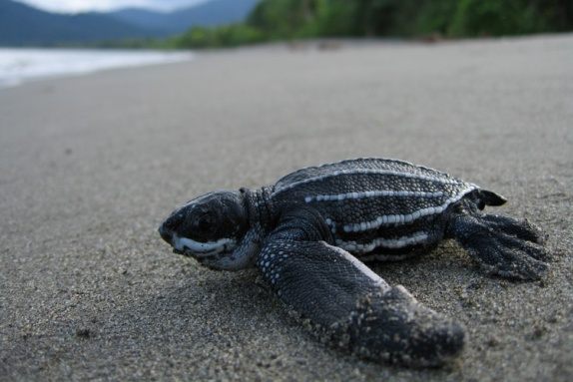
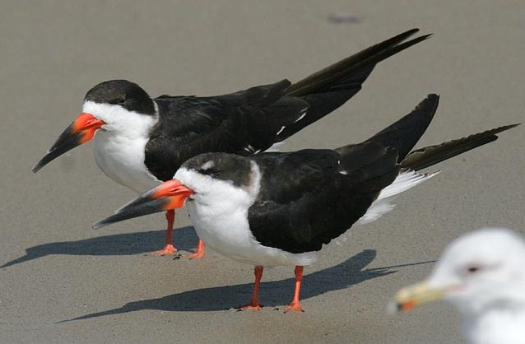
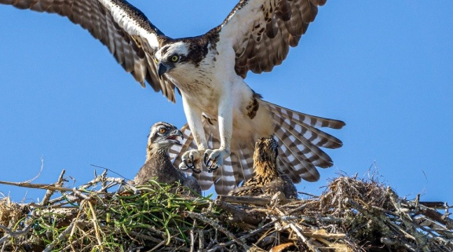
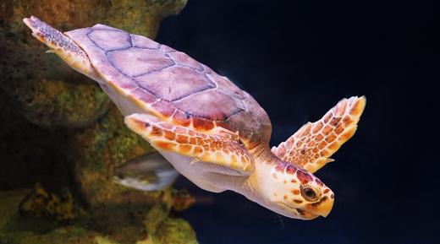
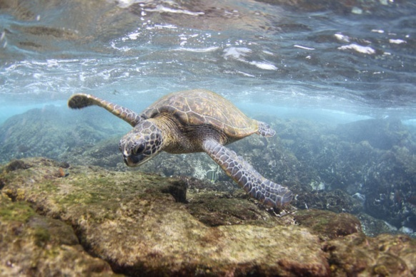
Sea Turtles and Sea Birds
Kemp’s Ridley Turtle NOAA
Brown Pelican Courtesy Connie Walker
Leatherback Turtle
Blue Heron Courtesy Connie Walker
Osprey NPS/Murphy
Loggerhead Turtle NOAA
Black Skimmers
Courtesy Glen Tepke
http://www.pbase.com/gtepke
Green Turtle NOAA

Slide 12
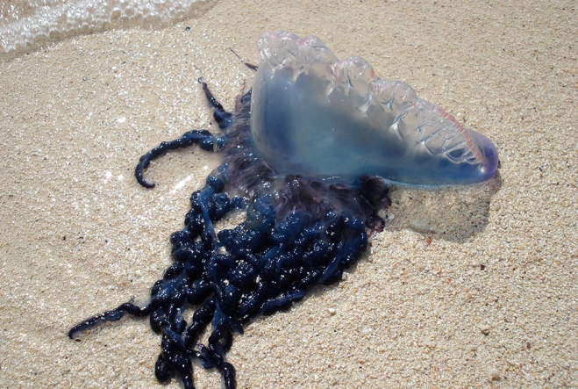
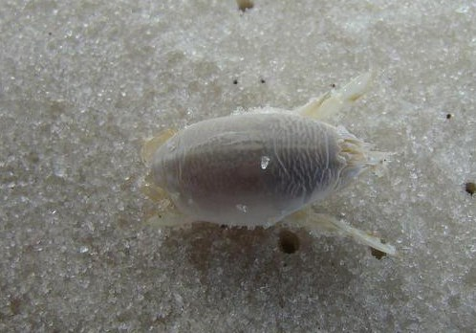
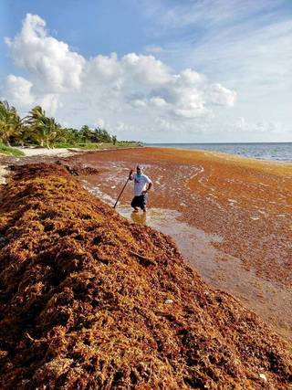
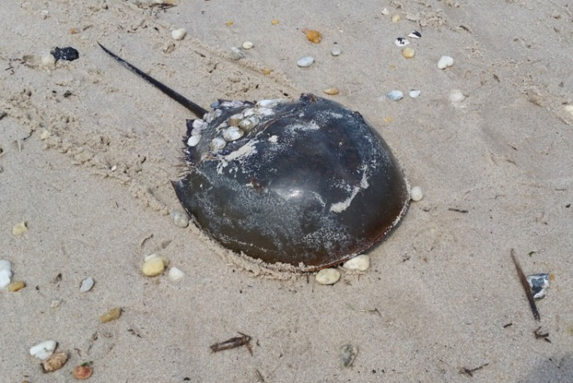
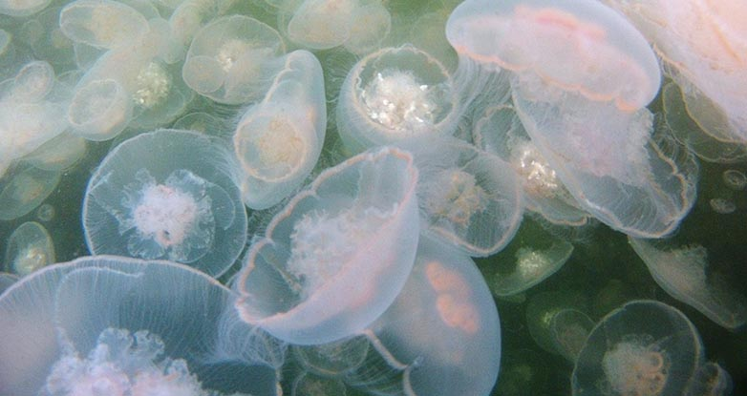
Along the Seashore
Sand Dollar
M. Reed NPS
Portuguese Man O’ War
Elizabeth Condon NSF
Sand Flea
Rebekah D Wallace NPS
Moon Jellies
Ecology.wa.gov
Horseshoe Crab
NOAA
Sargassum Seaweed
Michael Owen

Slide 13
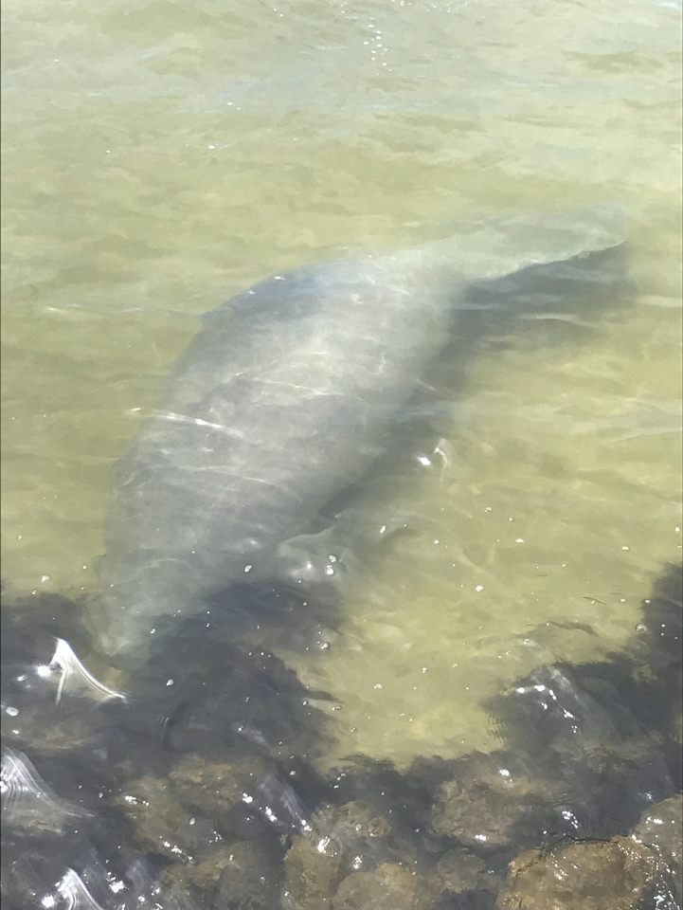
Florida’s Manatees
Manatees are increasingly sighted in the waterways of coastal Northwest Florida and Alabama; sightings should be reported to www.panhandlemanatee.org
Over 1,100 manatee deaths occurred in Florida in 2021, much more that the five year average of 100 deaths a year
According to director of the Save the Manatee Club Pat Rose: “It looks like we have a substantial number of manatees that are starving”; poor water quality from stormwater runoff leading to algae blooms and loss of sea grass could be responsible with some are surviving only from lettuce distributed by various organizations
Those using boats and jet skies on Florida waterways should take extra caution to avoid hitting these gentle giants
Keith Ramos USFWS
Nicole White April 2020

Slide 14
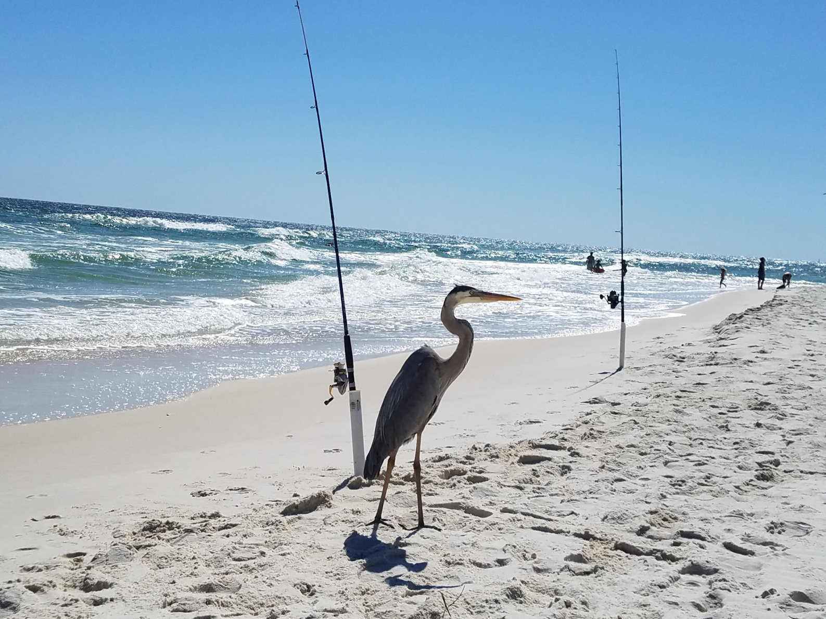
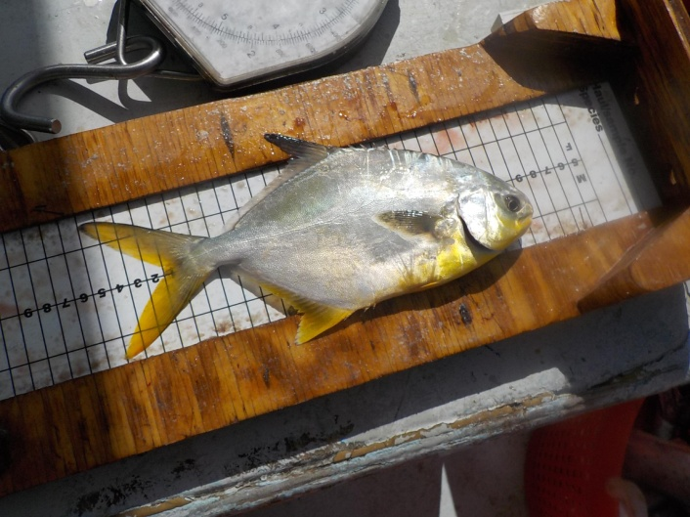
Fishing on Perdido Key
Surf fishing for pompano on Perdido Key often means a companion blue heron
NOAA Photo

Slide 15
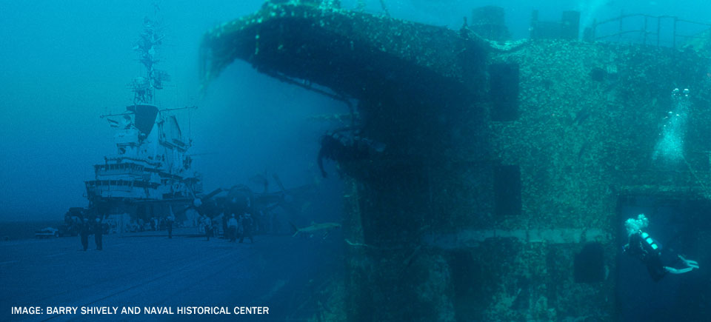
USS Oriskany Dive Site
The USS Oriskany CV/CVA 34) was a US Navy aircraft carrier commissioned in 1950 and saw service in the Korean and Vietnam Wars
In 2006, the decommissioned ship was deliberately sunk in 200 feet of water 22 miles south of the entrance to Pensacola Harbor and became the world’s largest artificial reef
It is an internationally known and popular diving location nicknamed the “Great Carrier Reef”
Florida Dept. of State Photo at http://www.floridapanhandledivetrail.com/oriskany.html

Slide 16
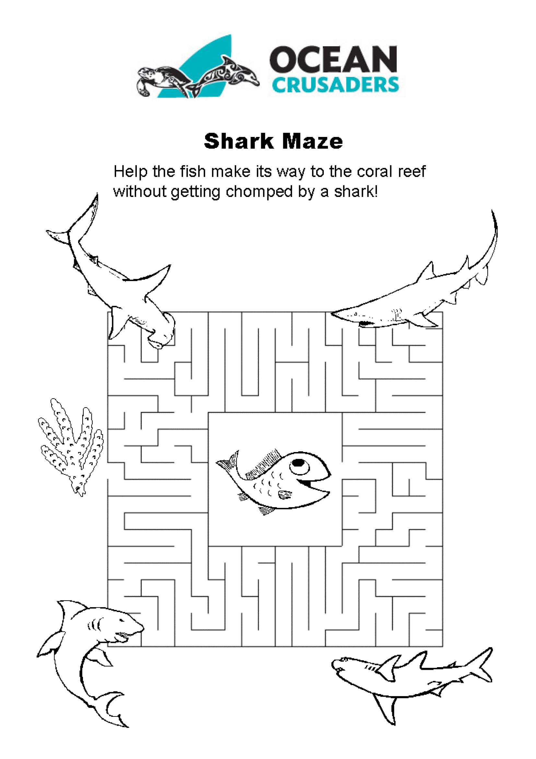

Slide 17
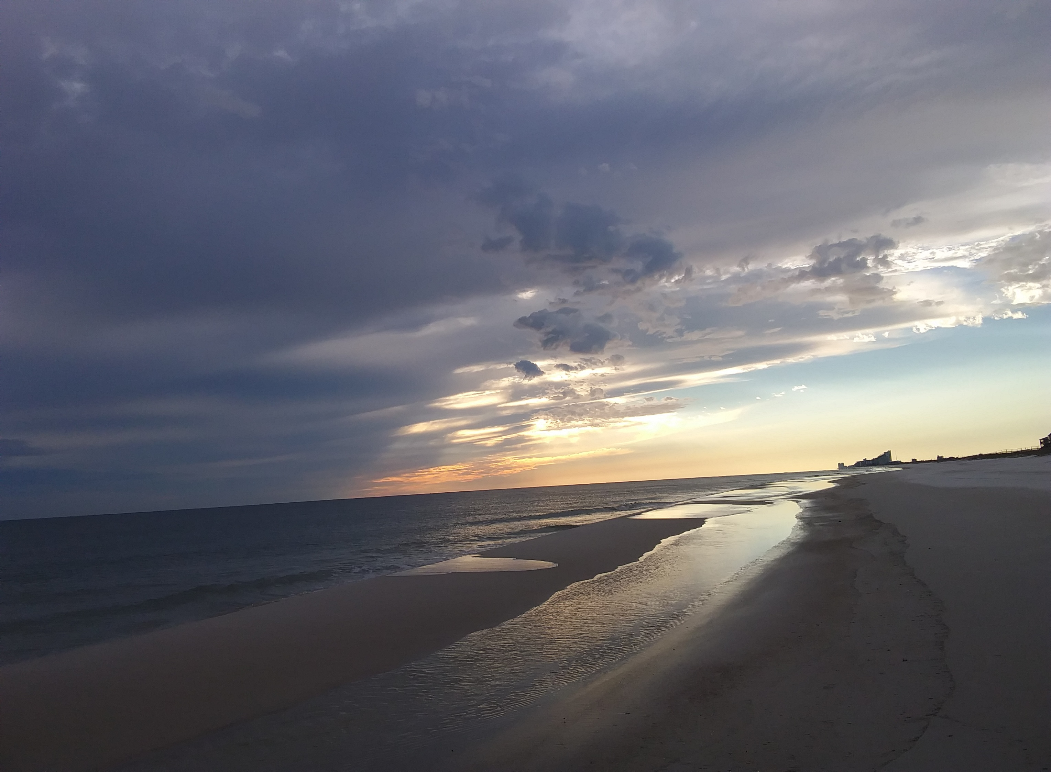
Oceans are Vast and Wonderful

