Slide 1
June 3 – Threats to the Oceans
Acidification
Pollution
Overfishing
Algae Blooms
Invasive Species
NOAA (National Oceanographic and Atmospheric Administration)
Ships and Buoys Collect Data on Acidification and other Threats to
the Oceans (NOAA Photo)

Slide 2
Additional information on ocean acidification can be found at the Nature Conservancy presentation “Ocean Acidification” at https://www.washingtonnature.org/oceanacidification and the EPA article “Effects of Ocean and Coastal Acidification on Ecosystems” at
https://www.epa.gov/ocean-acidification/effects-ocean-and-coastal-acidification-ecosystems

Slide 3
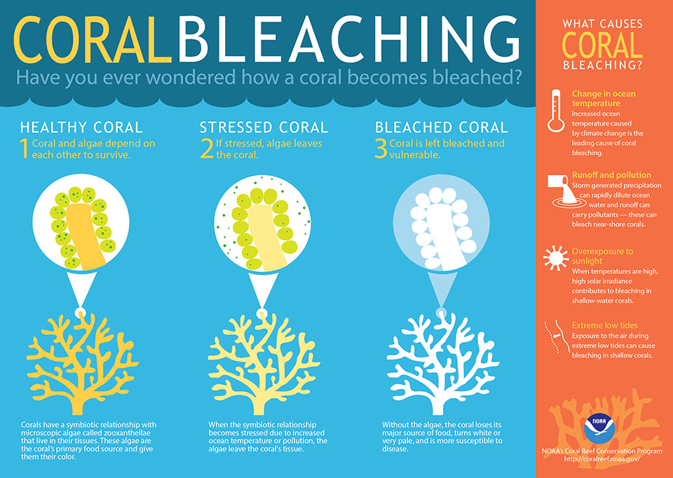

Slide 4
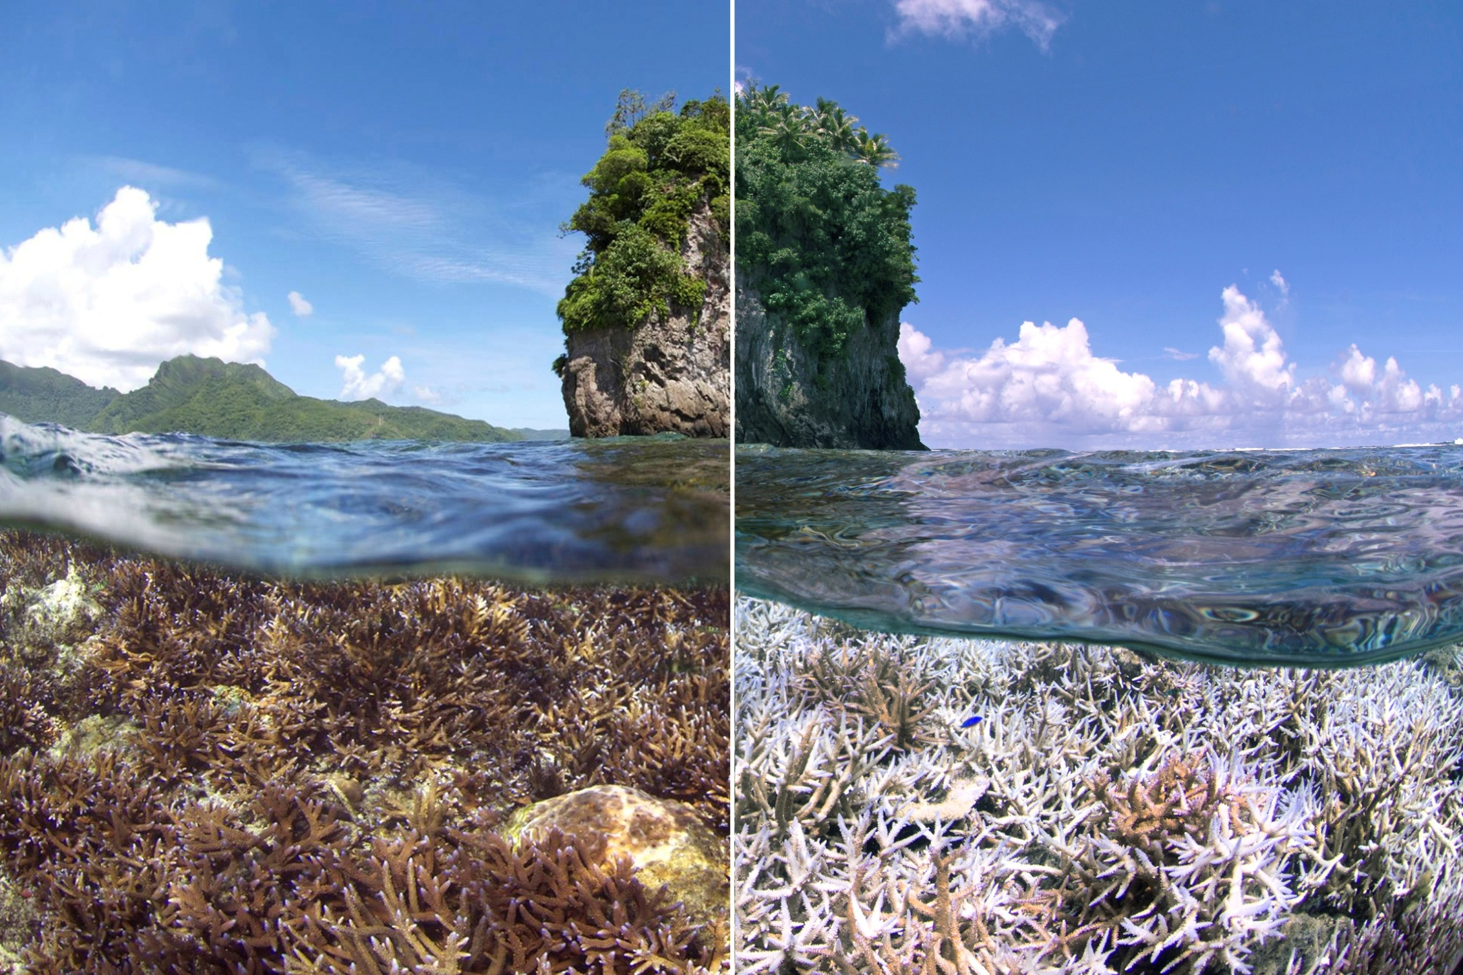
Coral Bleaching between 2014 and 2015 in American Samoa – NOAA Photo XL Catlin Seaview Survey

Slide 5
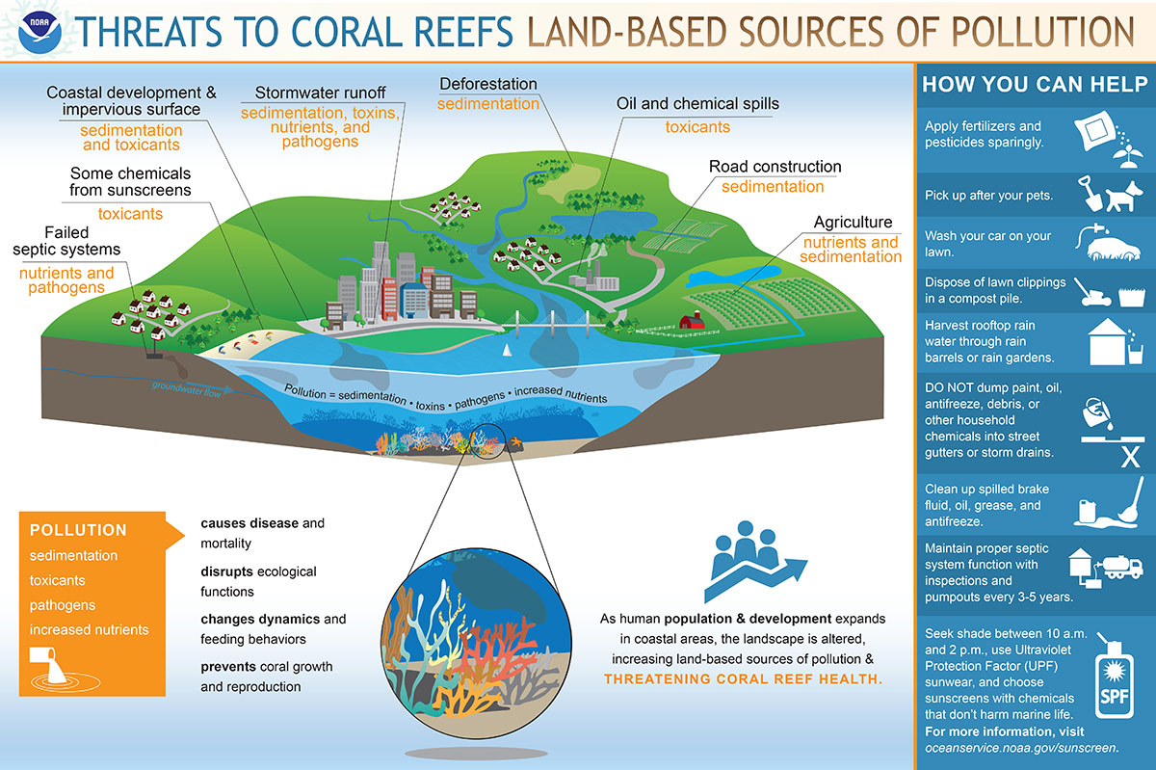

Slide 6
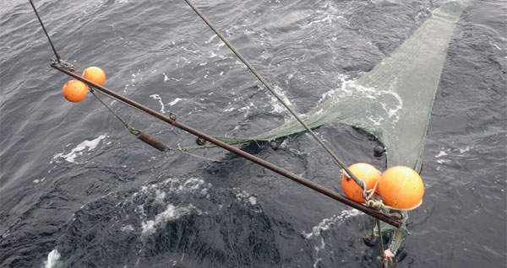
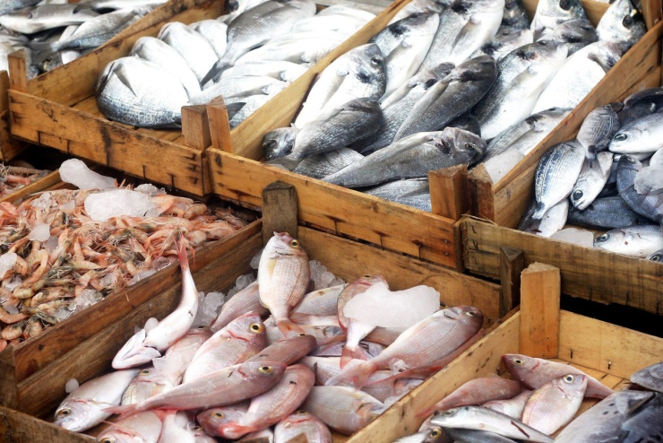
Overfishing
“Globally, a total of almost 80% of the world's fisheries are fully-to over-exploited, depleted, or in a state of collapse.”
“300,000 whales and dolphin are killed each year via by-catch”
“90% of predatory fish are gone: tuna, sharks, swordfish, cod, halibut”
Various national and international initiatives have been made to help maintain fish stocks
Information on this page from “Overfishing Around the World” https://sites.google.com/a/cornell.edu/overfishing-around-the-world/home
Commercial Trawl Vessel NOAA
Trawl NOAA
Fish Market NOAA

Slide 7
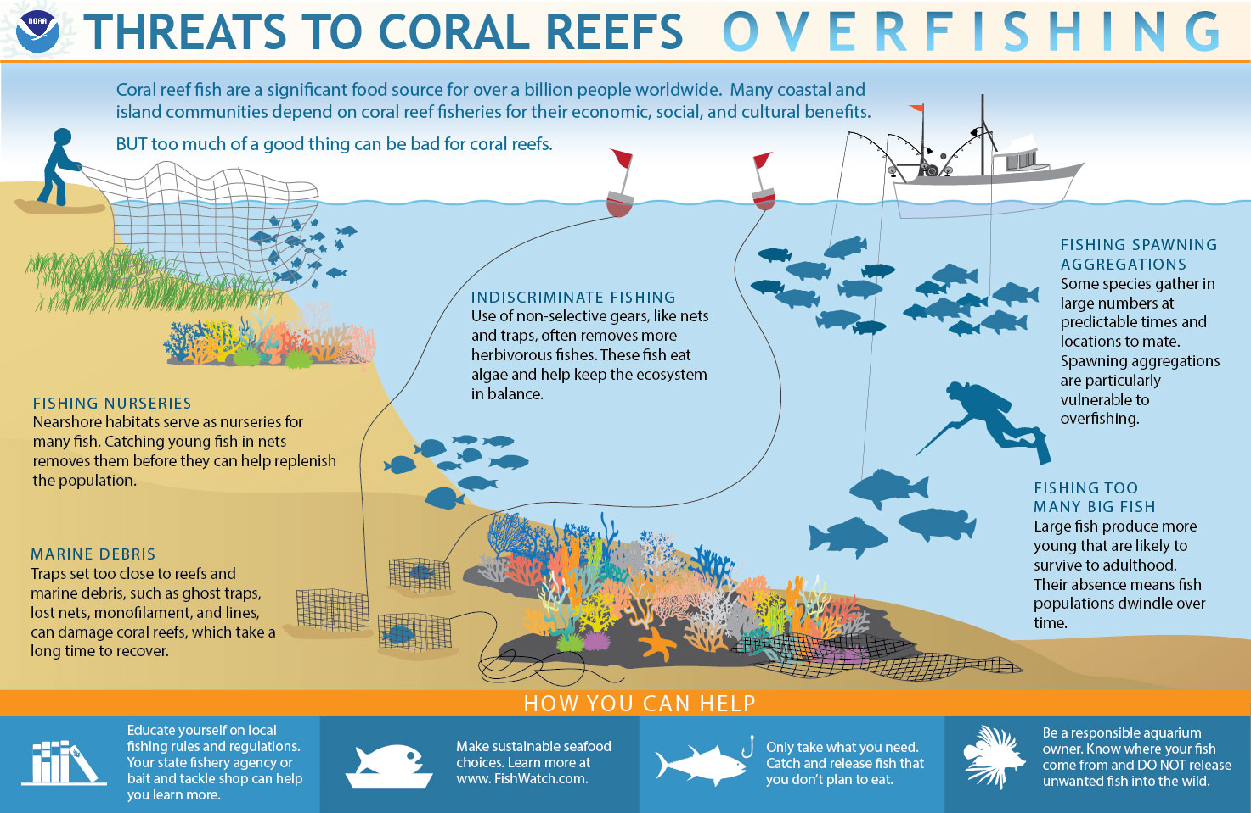

Slide 8
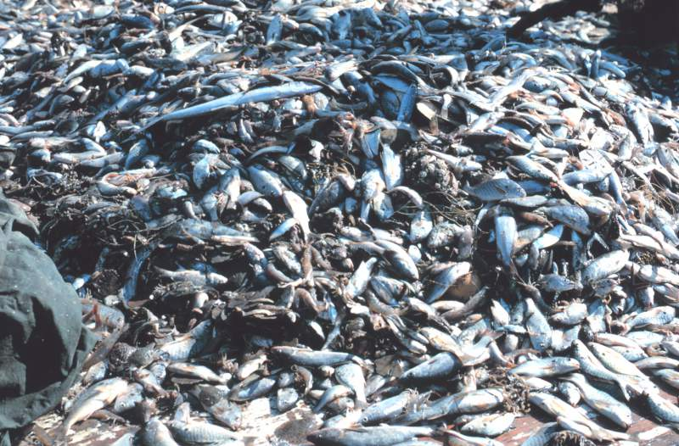
The Problem with Bycatch
Bycatch are marine species caught but not wanted during fishing operations; if fishing for tuna, you do not want dolphin; if fishing for shrimp, you do not want endangered sea turtles – but trawling, longline, and other intensive fishing techniques can be indiscriminate in what they catch
“All in all, bycatch may account for up to 40% of the global catch, or 63 billion pounds of non-target species per year” (From Planet Forward, “Bycatch: the forgotten story of the food industry,” March 15, 2017, by Ariel Kagan)
Estimates vary, but for every pound of shrimp caught, up to ten pounds of other marine life is thrown away
Bycatch can affect fish stocks and protected marine mammals and sea turtles
Various national and international initiatives have been made to mitigate bycatch
Drawn from NOAA Fisheries “Understanding Bycatch” June 19, 2017
For more on Bycatch, go to https://www.fisheries.noaa.gov/insight/understanding-bycatch
Bycatch from Commercial Shrimping NOAA
Entangled Whale NOAA

Slide 9
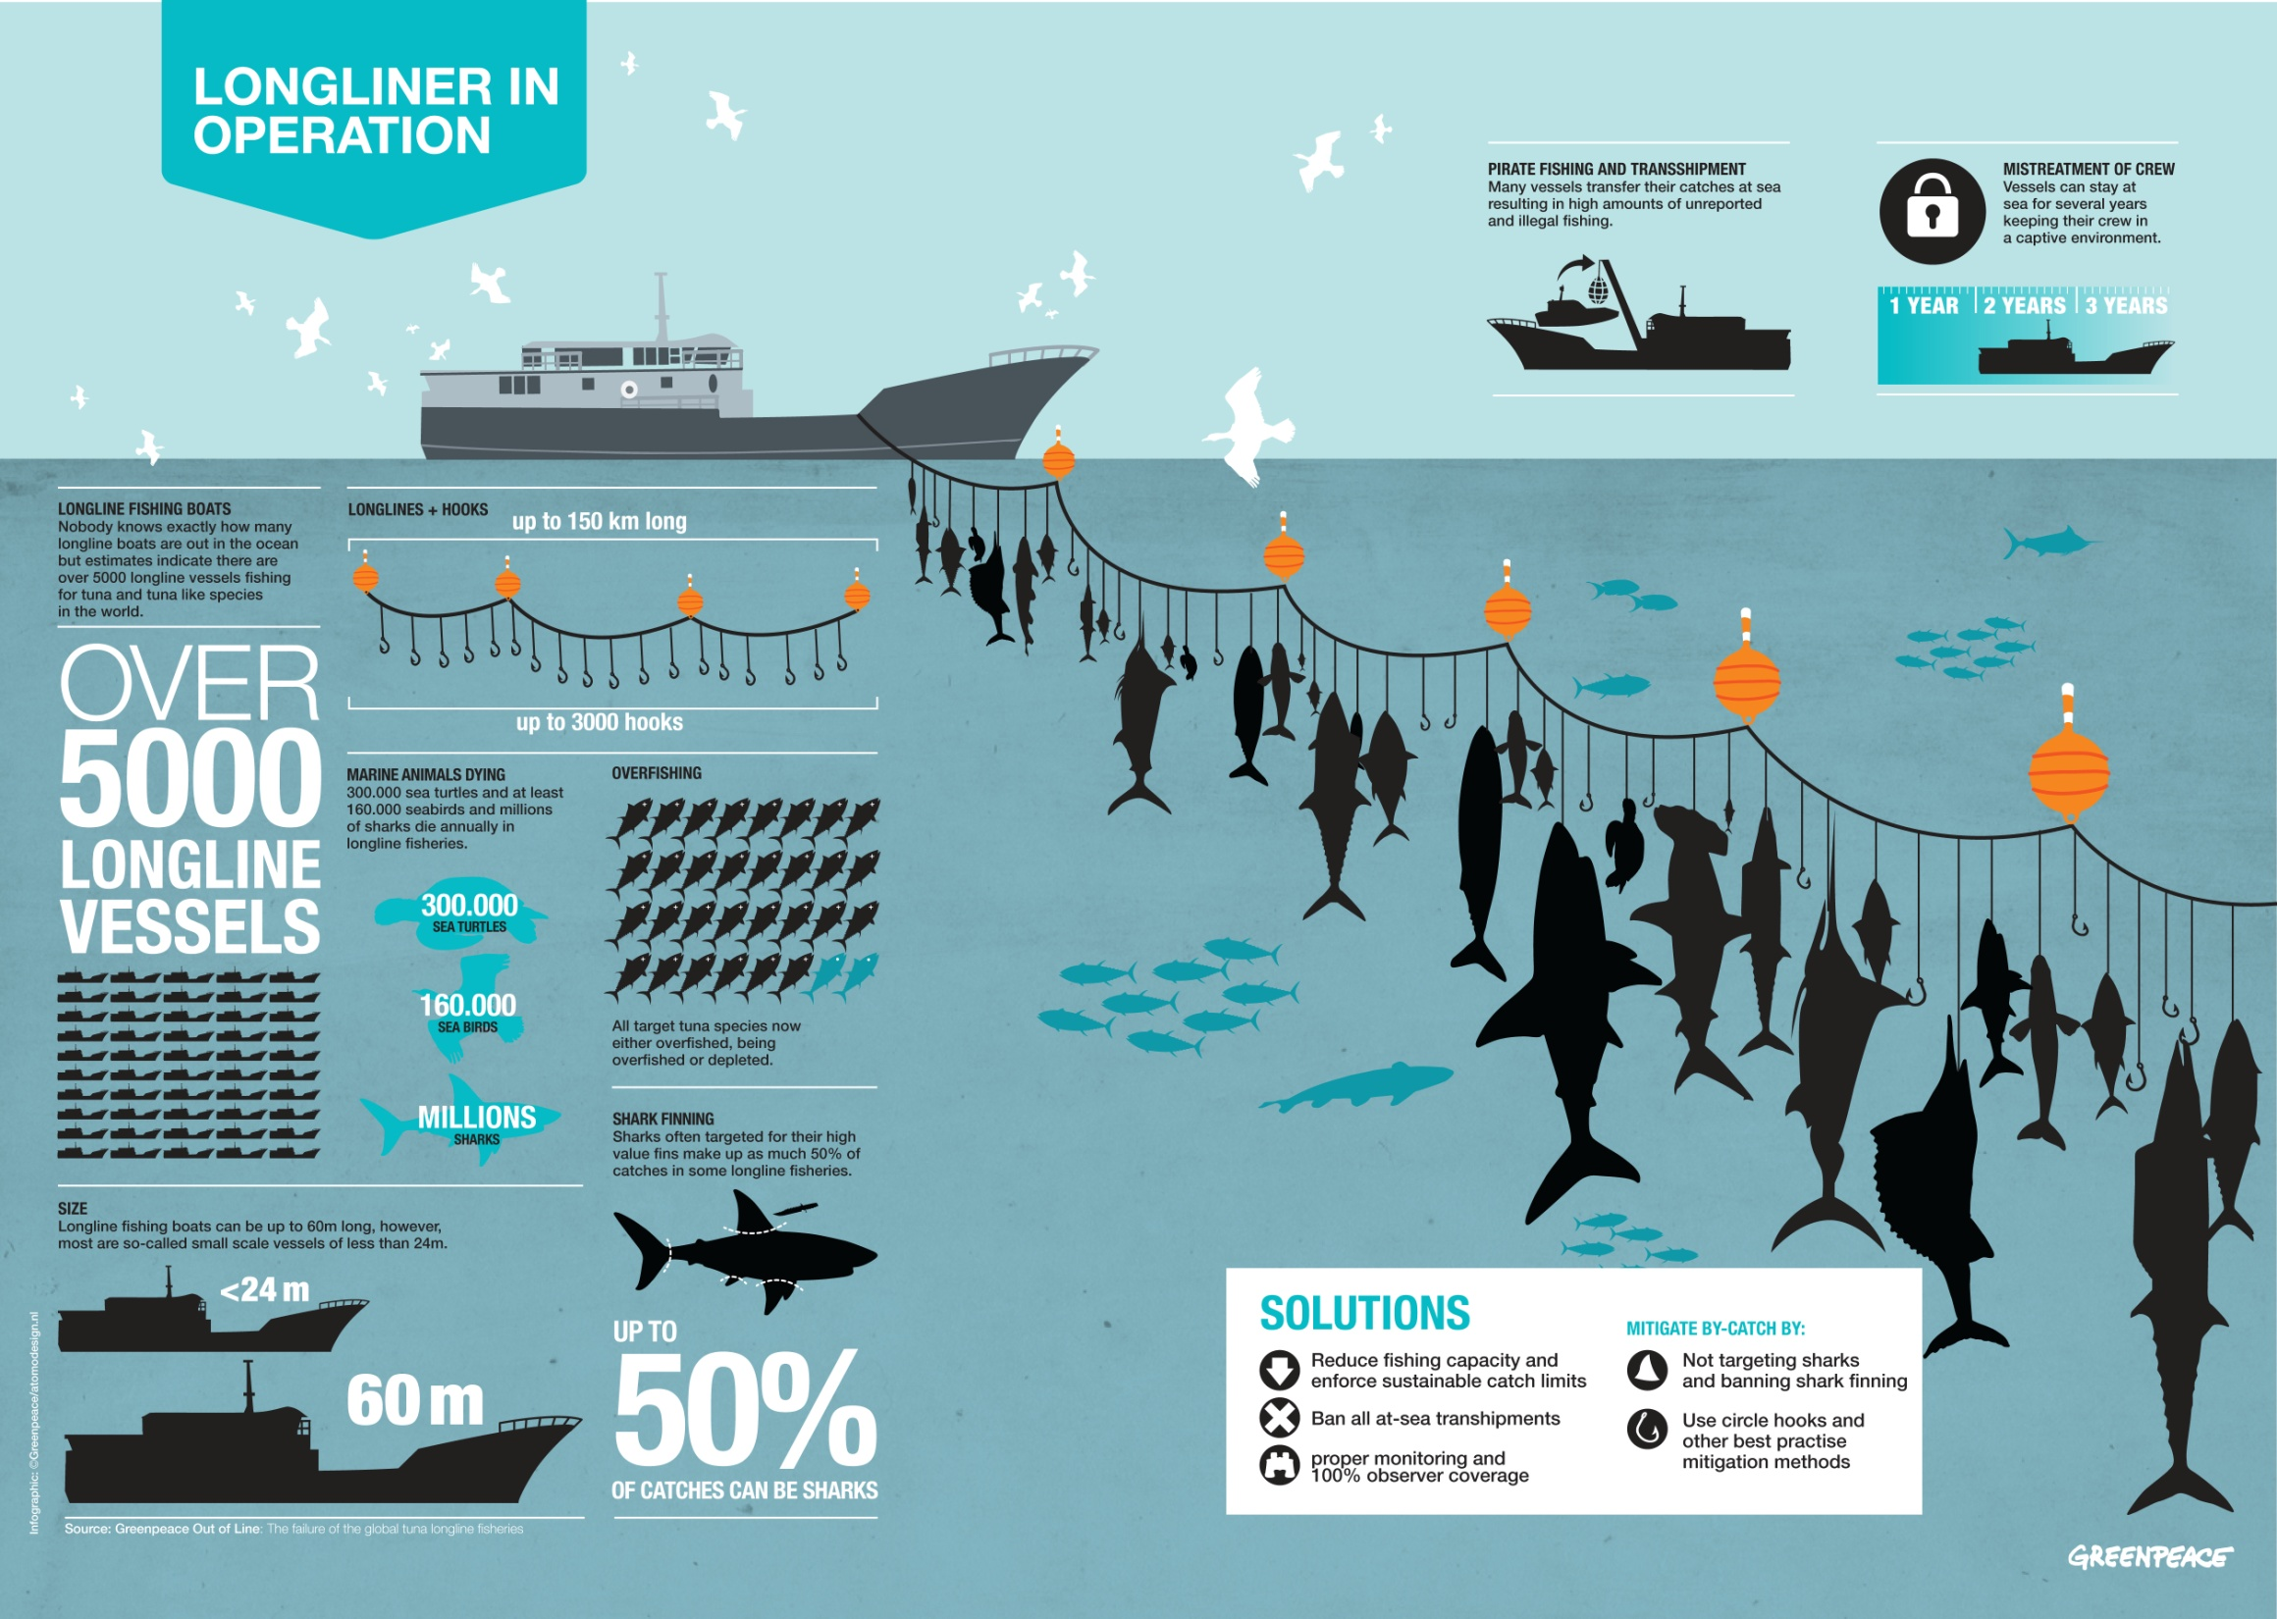
NOAA and Greenpeace (GPI – LonglineInfographic – RGB – DEF)

Slide 10
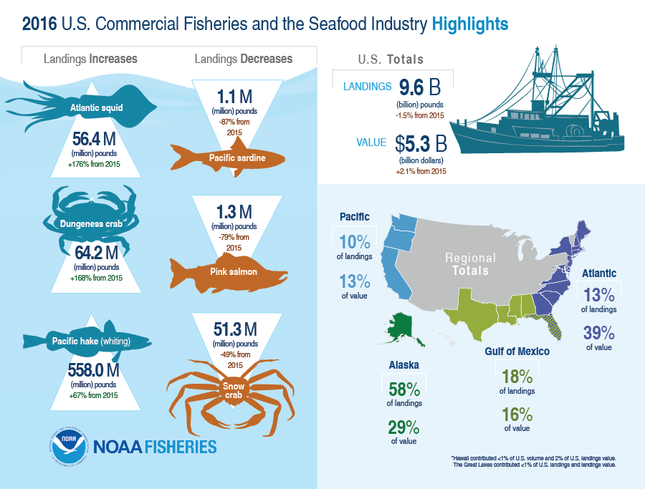
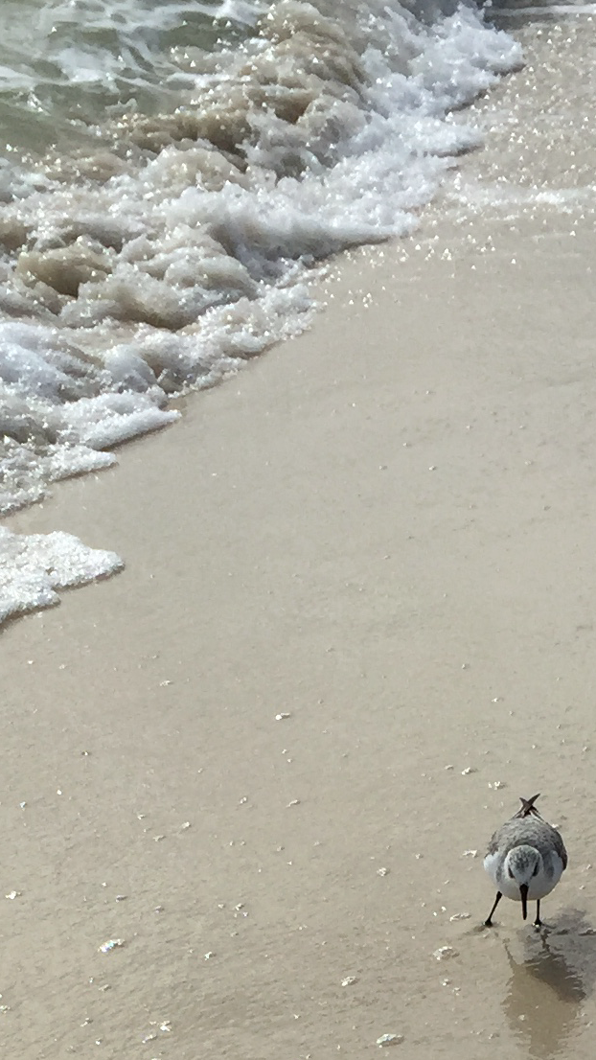
Go to https://www.fisheries.noaa.gov/national/sustainable-fisheries/fisheries-united-states for US Commercial Fishing and Seafood Industry
A Walk on the Beach
Courtesy Connie Walker

Slide 11
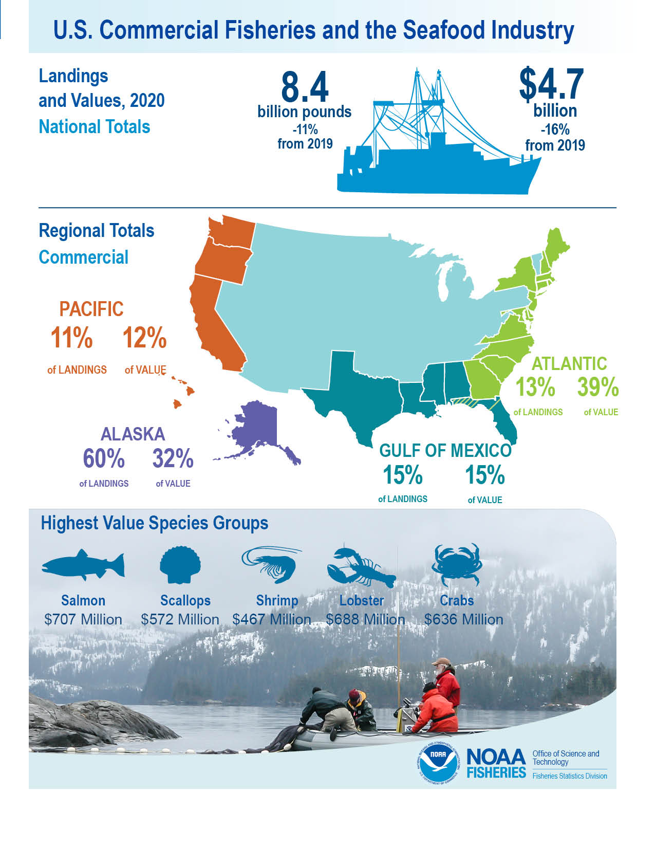
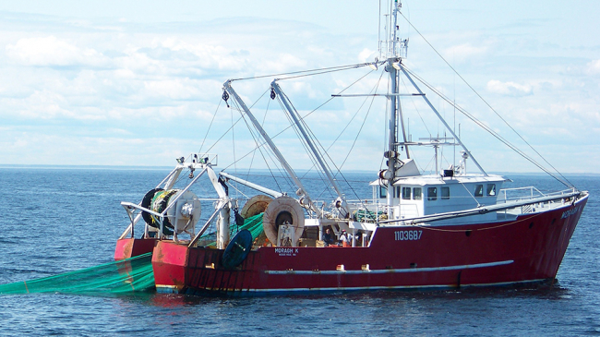
Commercial Trawler NOAA Photo
Available at https://www.fisheries.noaa.gov/national/sustainable-fisheries/fisheries-united-states for US Commercial Fishing and Seafood Industry

Slide 12
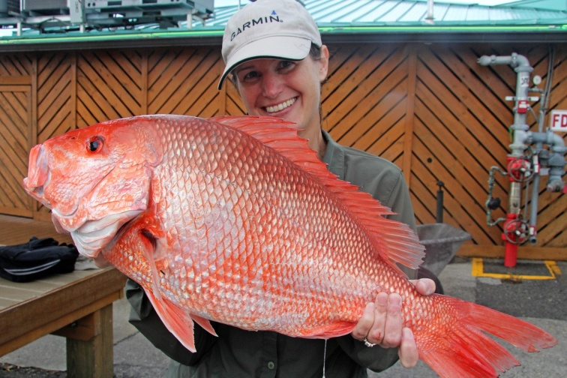
Great Red Snapper Count in the Gulf of Mexico
Red snapper are among the most important commercial and recreational fishing catch on the Gulf Coast
Red snapper fishing stocks are monitored and the yearly fishing limits and dates anxiously awaited
Management of red snapper stocks is shared among the federal government and states bordering the Gulf of Mexico
For more on red snapper management, go to NOAA’s “History of Management of Gulf of Mexico Red Snapper” at https://www.fisheries.noaa.gov/history-management-gulf-mexico-red-snapper
For more information, go to
https://www.harte.org/snappercount
Red Snapper (NOAA Photo)

Slide 13
Toxic Algae
Left: K. brevis, the species that causes red tide and associated fish kills. Right: The dominant cyanobacteria (Microcystis aeruginosa) responsible for the blue-green algal bloom in Lake Okeechobee, 2018. From Krista Stump UF/IFAS Blog

Slide 14
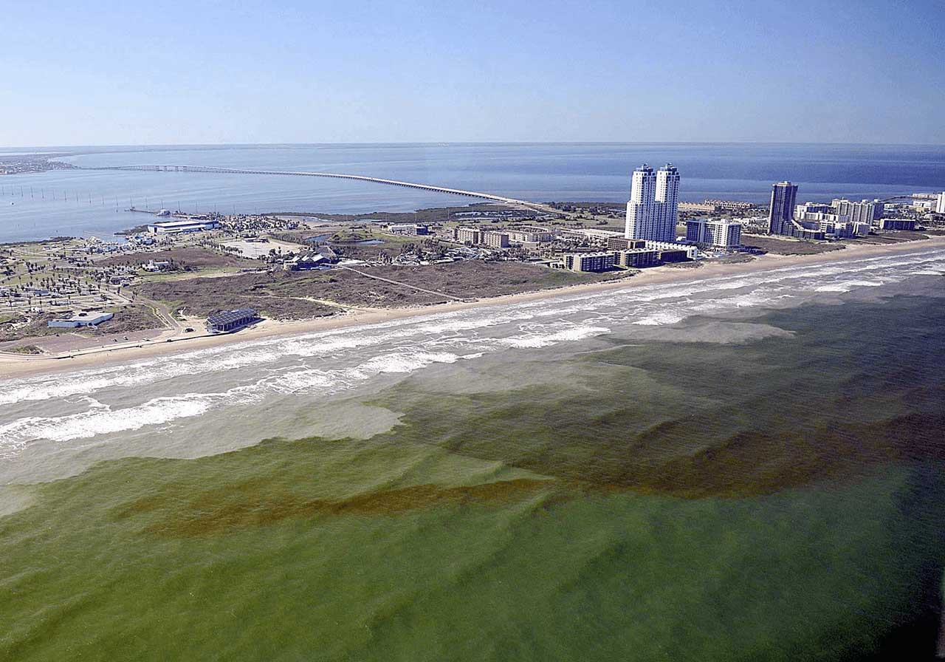
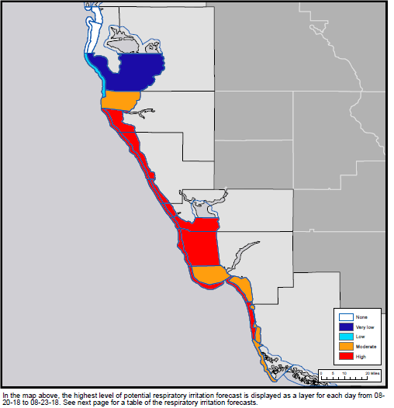
Red Tide
Red tide is caused by karenia brevis, a species of dinoflagellates – a type of plankton
Karenia brevis produces “brevetoxin” that can affect the central nervous system of fish and other marine life, killing many; people can suffer respiratory and eye ailments from the airborne brevetoxin
Florida red tide blooms often form 10-40 miles offshore in the Gulf of Mexico but can be driven toward land by wind, tide and current
Scientists do not know what causes red tide blooms, though nutrient runoff from land may prolong bloom duration
Drawn from Maia McGuire UF/IFAS Blog
More about Red Tide is available at https://scijinks.gov/red-tide/
Red Tide on Texas coast NOAA
Dead Fish from Toxic Algae off
Sarasota, Florida NOAA National Centers for Coastal Ocean Science
NOAA’s Southwest Florida “Red Tide” Respiratory
Irritation Forecast for August 20, 2018 NOAA.

Slide 15
Blue-Green Algae
Lake Okeechobee is prone to large algae blooms in warm sunny periods when heavy rainfall cause inflows of phosphorus and nitrogen rich water from its watershed
Some, but not all, blue-green algae release toxins that can kill fish and wildlife
Microcystis aeruginosa can produce the hepatoxin (liver toxin) microcystin which can cause gastro-intestinal and possible liver problems in humans if ingested
Some blue-green algae produce neurotoxins (nervous system toxins) that can cause respiratory system and eye irritation and dermatoxins associated with skin irritation
Drawn from Lisa Krimsky UF/IFAS blog
NOAA National Centers for Coastal Ocean Science
M. Parsons FGCU

Slide 16
Toxic Algae
For more on toxic algae go to the Sea Grant online publication “State of Science for Toxic Algal Blooms in Florida” at https://chnep.wateratlas.usf.edu/upload/documents/SGR-136-HAB-Science-Aug2019.pdf
and NOAA’s “Gulf of Mexico/Texas Harmful Algae Blooms” at https://oceanservice.noaa.gov/hazards/hab/gulf-mexico.html

Slide 17
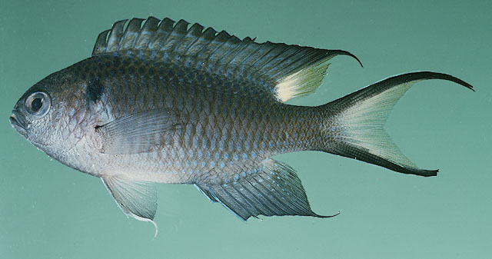
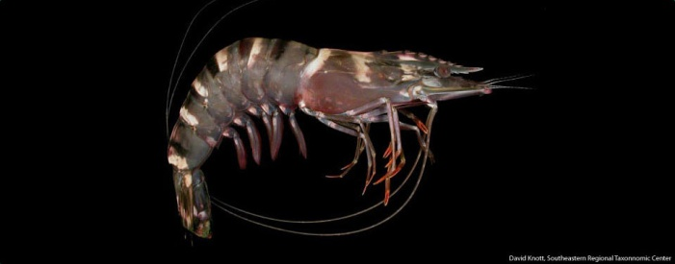
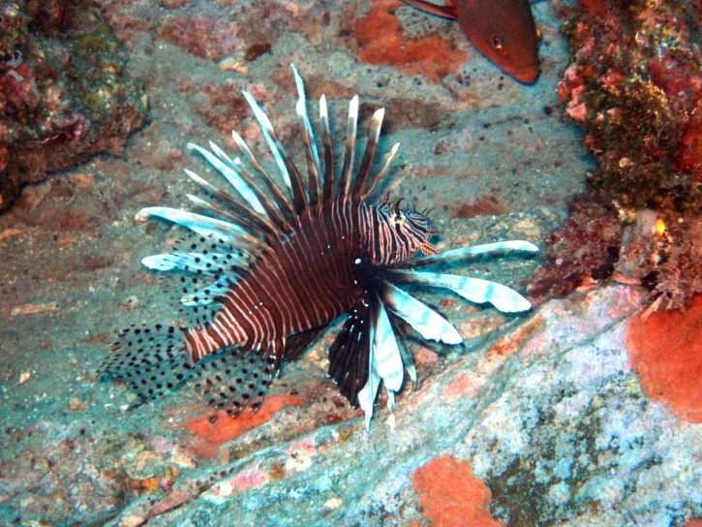
Some Invasive Species in Gulf Waters
Regal Demoiselle are from the Indo-Pacific and were found off the Mexican coast in 2013; they were identified in Northern Gulf of Mexico waters in 2017, particularly near oil rigs, but their effect on local species is unknown (USGS)
Asian Tiger Shrimp from the Indo-Pacific have been found in Gulf waters since 2002; their local effects are uncertain (USGS)
Lionfish are also from the Indo-Pacific and are a popular aquarium fish, which may be how they arrived in Gulf waters in the early 1990s; they are voracious predators and have greatly multiplied; efforts to control their numbers with lionfish hunting tournaments and other means are ongoing
Regal Demoiselle USGS-NAS
Asian Tiger Shrimp NOAA
Lionfish NOAA

Slide 18
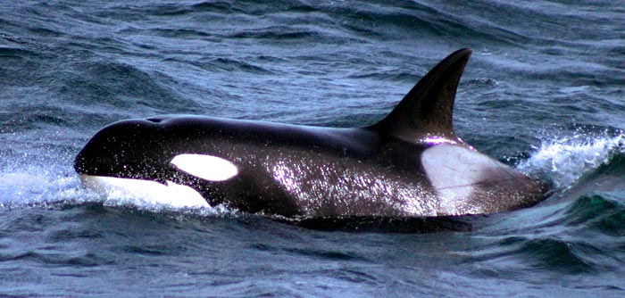
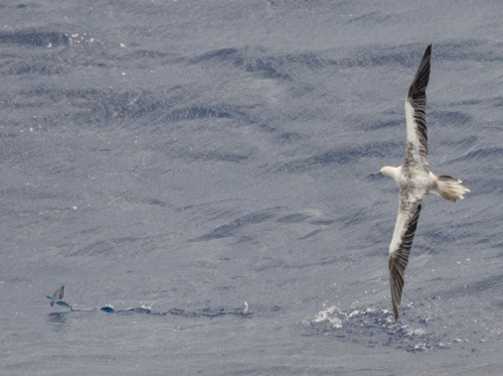
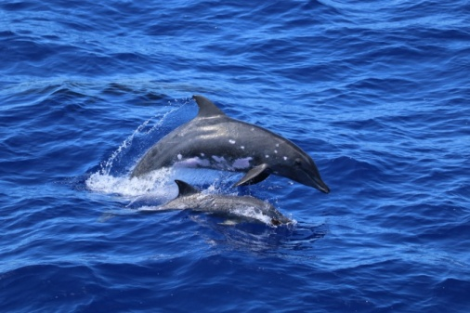
Killer Whale NOAA
Red-Footed Booby and Flying Fish
Bernardo Alps NOAA
Rough Toothed Dolphin
Marie Hill NOAA

