Slide 1
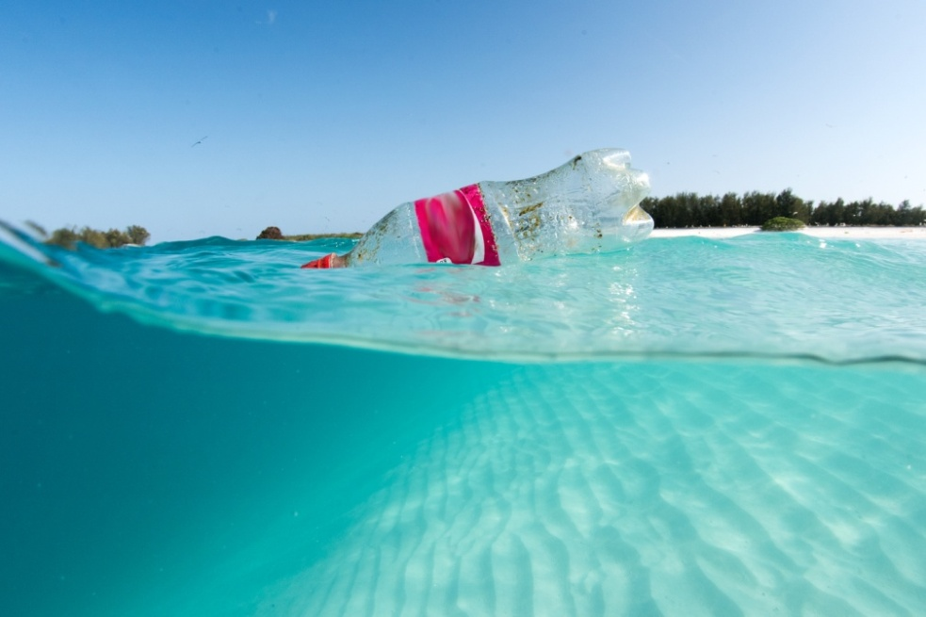
June 4 – Plastic in the Oceans
Single use items like plastic bottles and bags can end up in the oceans if not disposed of properly
Scientists estimate that about 8 million metric tons of plastic enter the oceans every year, the weight of nearly 90 aircraft carriers
Plastics do not decompose quickly so they continue to build up and cause damage to the marine ecosystem
Information from NOAA’s “A Guide to Plastics in the Ocean” at https://oceanservice.noaa.gov/hazards/marinedebris/plastics-in-the-ocean.html
By 2050 the weight of plastics in the oceans will exceed that of fish
Earthday.org Fact Sheet: Plastics in the Ocean at https://www.earthday.org/fact-sheet-plastics-in-the-ocean/
Plastic bottle in waters near remote Northwestern
Hawaiian Island NOAA Photo

Slide 2
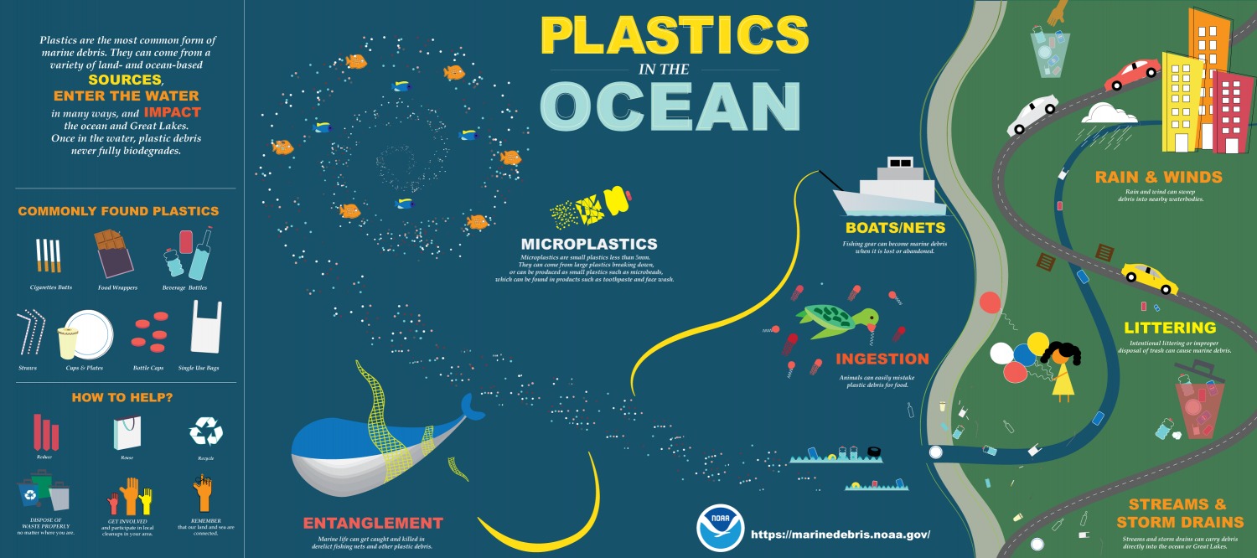

Slide 3
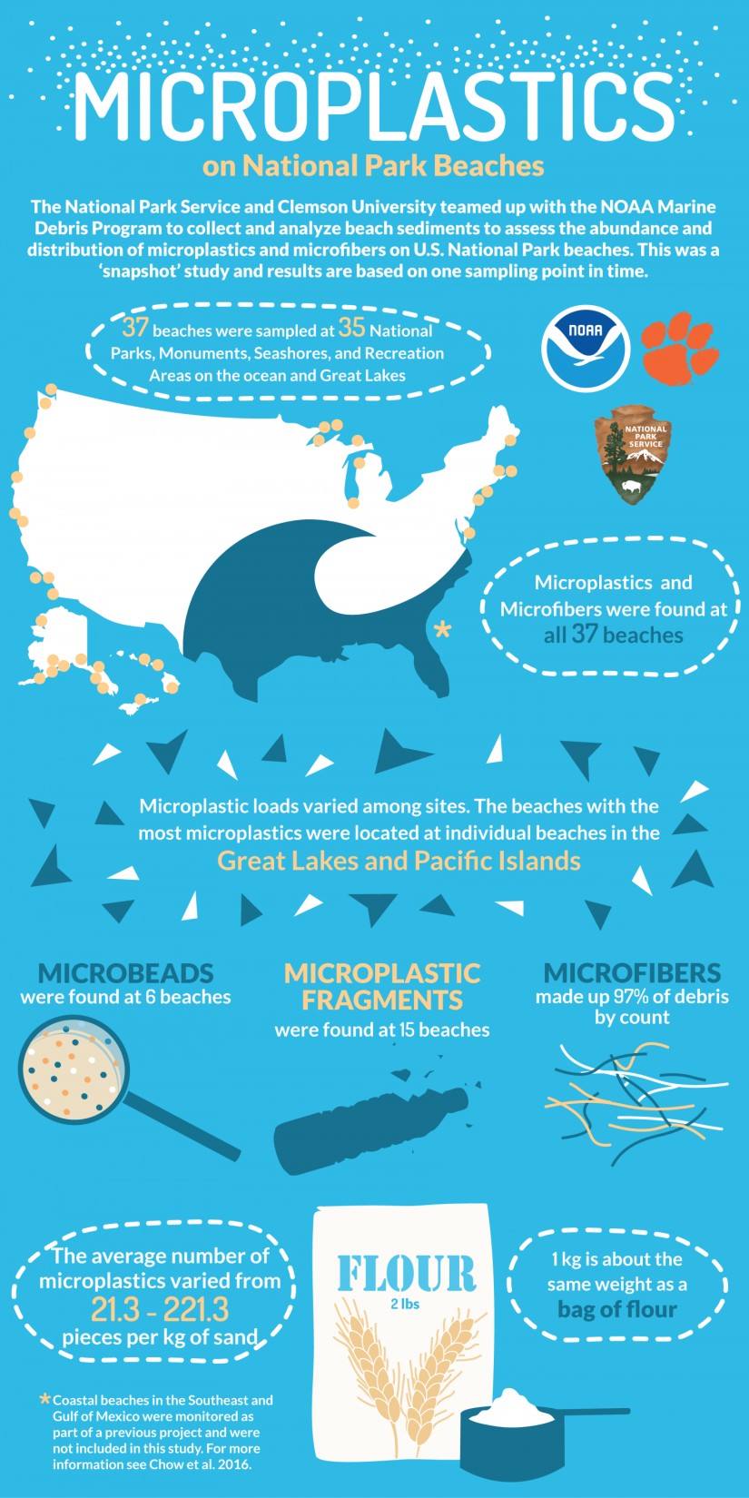
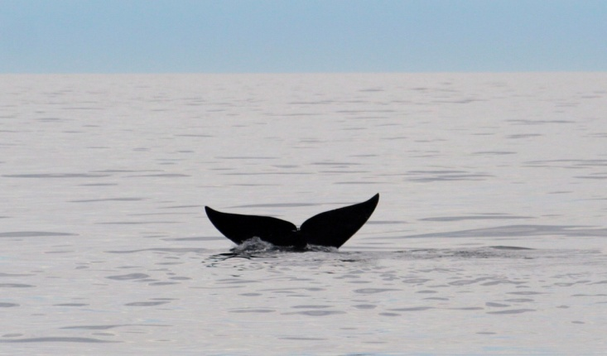
Microplastics in the Oceans
Microplastics are small beads found in products such as some soaps and toothpaste; they include plastic bits reduced over time from larger items
Microfibers from synthetic clothing and fishing nets and microplastics can absorb pesticides and other pollutants and release them to the oceans; see https://oceanservice.noaa.gov/hazards/marinedebris/plastics-in-the-ocean.html
Algae can collect microplastics which then move up the food chain to small marine creatures and even to giant whale; see NOAA’s “Marine Debris Program” at https://blog.marinedebris.noaa.gov/microplastics-megafauna
In 2022 researchers detected microplastics in human blood for the first time although additional research is needed to determine what effect if any microplastics can have on human health; see https://www.theguardian.com/environment/2022/mar/24/microplastics-found-in-human-blood-for-first-time
NOAA Photo by Demi Fox

Slide 4
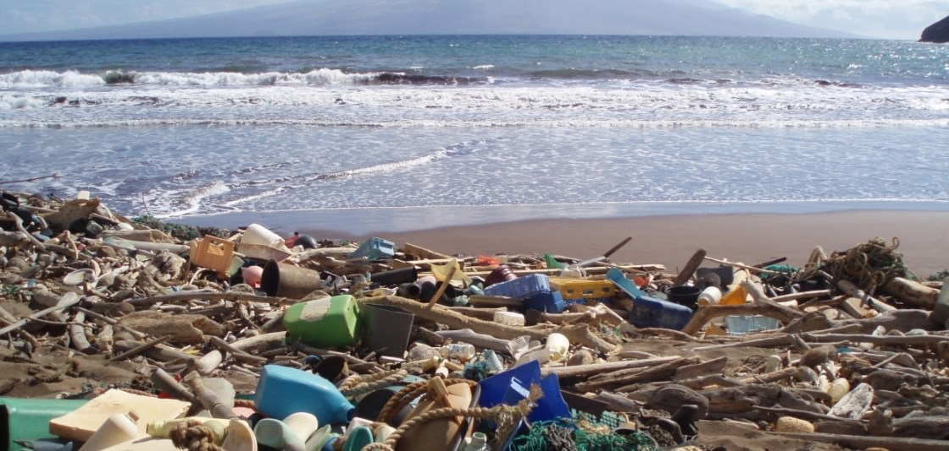
Trash on our Beaches!
“Catcher Beach” in Hawaii NOAA Photo
Volunteers Cleaning Up
Perdido Key Beaches on
International Coastal Cleanup
Day held September each year

Slide 5
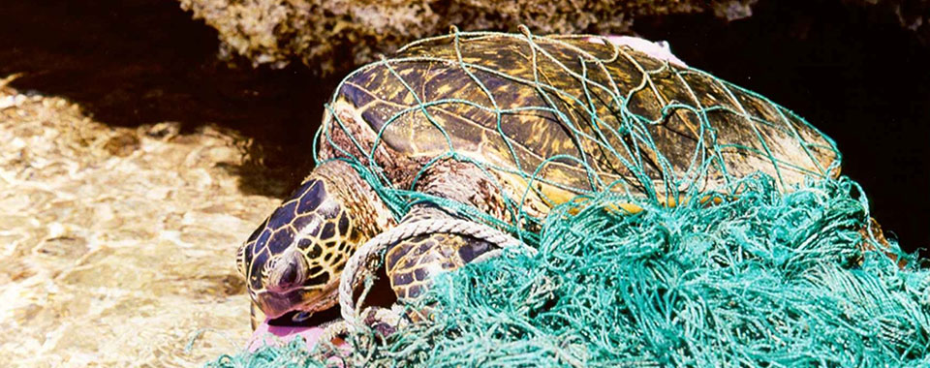
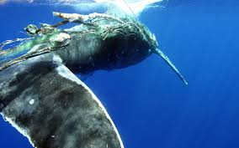
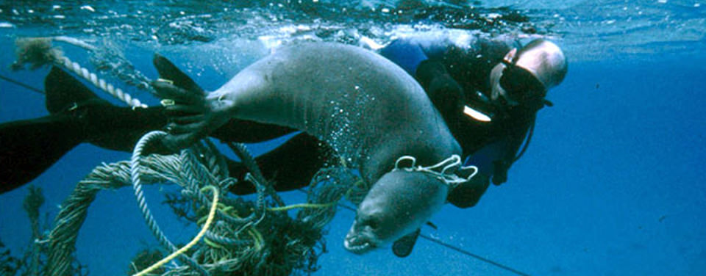
Plastic Entanglement and Ingestion
Humpback Whale Entangled, NOAA Photo
A 10 meter 6 ton sperm whale was found on a beach in Spain in 2018, among other sperm whale deaths in recent years; autopsy revealed it had ingested over 60 pounds of plastic bags and other plastic debris
From April 7, 2018 International Business Times Singapore article “Sperm Whale found dead after swallowing Plastic Bags” by Bhaswati Guha Majumder at https://www.ibtimes.sg/sperm-whale-found-dead-after-swallowing-plastic-bags-undp-development-goal-failing-25792
NOAA Photos

Slide 6
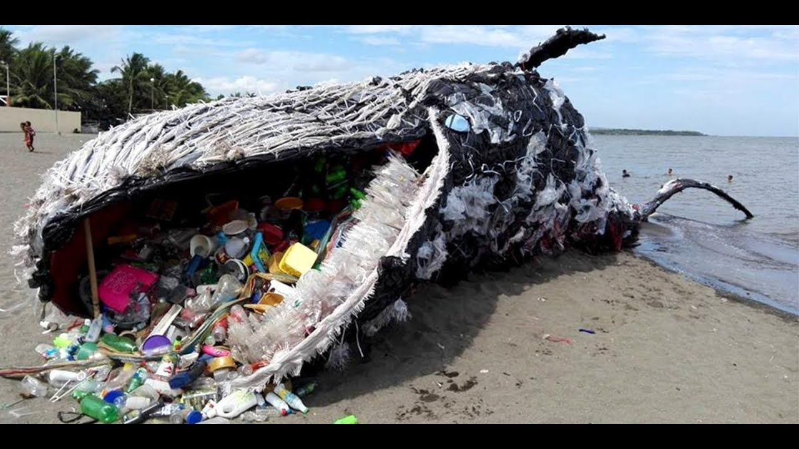
Greenpeace Philippines Plastic Whale
See YouTube video of Greenpeace Philippines Plastic Whale at
https://www.youtube.com/watch?v=aq6LNsJyqEE

Slide 7
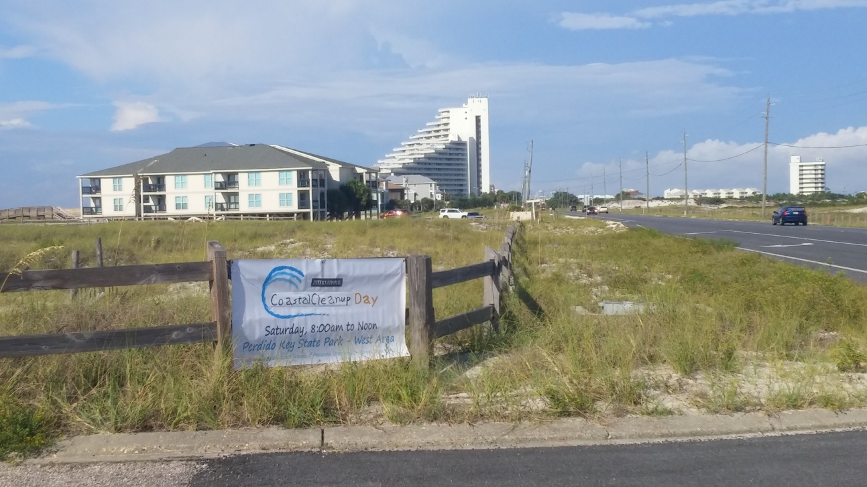
Ocean Trash at a Glance 2020 International Coastal Cleanup Day
Cigarette Butts – 964,521
Plastic Bottles – 627,014
Food Wrappers – 573,534
Other Trash – 519,438
Bottle Caps – 409,855
Grocery Bags – 272,399
Straws, Stirrers – 224,170
Take Out Containers – 222,289
Beverage Cans – 162,750
Glass Bottles – 146,255
Participants – 221,589
Pounds – 5,229,065
Miles – 49,635
Total Items – 8,066,072
Tiny Trash (less
than 2.5 cm)
Foam – 364,218
Glass – 81,002
Plastic – 1,685,206
The Ocean Conservancy report on trash collected during the 2020 International Coastal Cleanup Day at https://oceanconservancy.org/wp-content/uploads/2021/09/2020-ICC-Report_Web_FINAL-0909.pdf

Slide 8
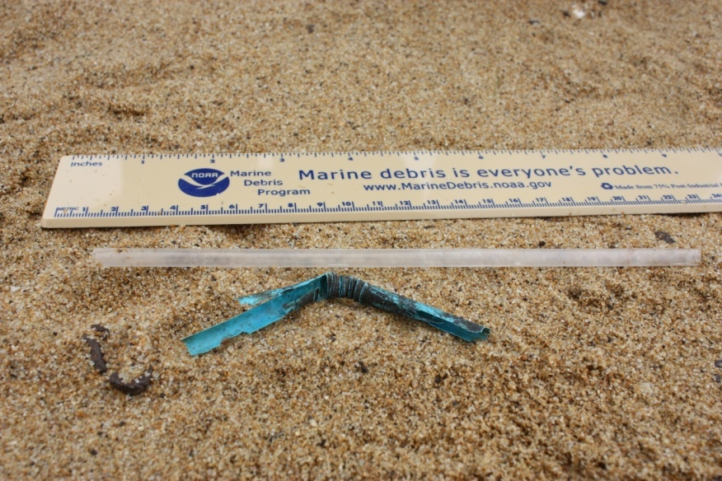
Deadly Ocean Trash?
According to the Ocean Conservancy, the most dangerous kinds of ocean trash are:
Fishing gear
Plastic Bags and Utensils
Balloons
Cigarette Butts
Bottle Caps
For more information, go to Ocean Conservancy article “How Dangerous is Ocean Plastic? Insights From Global Experts on the Greatest Threat to Marine Wildlife” at https://oceanconservancy.org/blog/2016/01/12/how-dangerous-is-ocean-plastic/
Plastic straws can also be a hazard; their small size makes them easy for many marine creatures to ingest; straws also break down over time into microplastics
For more on straws and the oceans, go to https://only.one/read/gateway-to-a-plastic-revolution
NOAA Photo

Slide 9
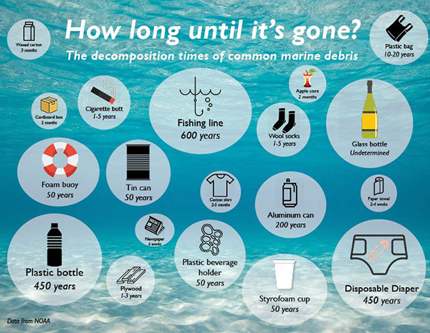
NOAA and Leon County, Florida

Slide 10
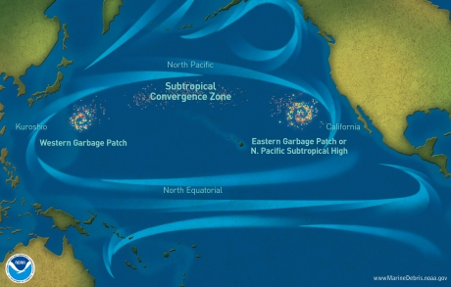
Sweeping Plastic from the Great Pacific Garbage Patch
Garbage patches are locations where trash tends to accumulate in the oceans because of rotating currents called “gyres”
24 year old Boyan Slat and Dutch scientists have designed a 2,000 ft floating boom to capture and retain debris in the Great Pacific Garbage Patch (shown here as “Eastern Pacific Patch), a region twice the size of Texas and the world’s largest garbage patch
The boom has a 10 foot screen below it to trap plastic but not harm marine life
The Guardian October 3, 2019 “Ocean Cleanup Device Successfully Collects Plastic for First Time” by Daniel Boffey
The Ocean Project
For more on the project, go to The Ocean Cleanup website at https://theoceancleanup.com/oceans/
CBS News coverage video at https://www.youtube.com/watch?v=r4rCng_-0Rc
Updates at the Smithsonian’s https://www.smithsonianmag.com/smart-news/this-new-installation-just-pulled-20000-pounds-of-plastic-from-the-great-pacific-garbage-patch-180978895/
For more on ocean “gyres” and “garbage patches” go to
https://marinedebris.noaa.gov/info/patch.html

Slide 11
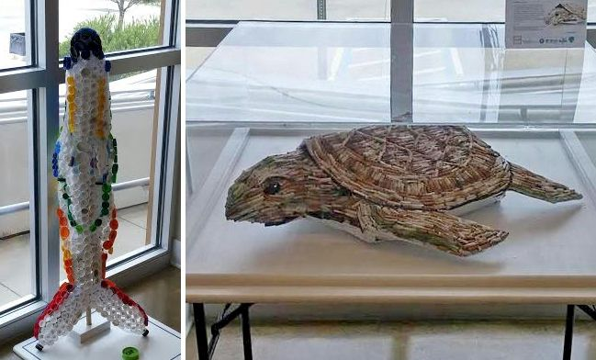
CAP and CIG
To help us appreciate the damage plastics can do to our oceans and the marine creatures that live there, artist Shelly Marshall created CAP from plastic bottle caps and CIG from cigarette butts collected along Pensacola Beach; cigarette filters give CIG its color
CAP and CIG make their home at the Perdido Key Visitors Center
CAP
CIG

Slide 12
Our Plastic Future
“Plastics now pollute all dimensions of our ocean from the sea surface to the seafloor, on remote beaches and in Arctic sea ice. The impact ocean plastics have on marine species is well documented, but increasingly scientists are concerned about the potential threat of plastics to species at the top of the marine food chain: humans.”
Nicholas Mallos, Senior Director, Trash Free Seas®, Ocean Conservancy, at https://oceanconservancy.org/trash-free-seas/

Slide 13
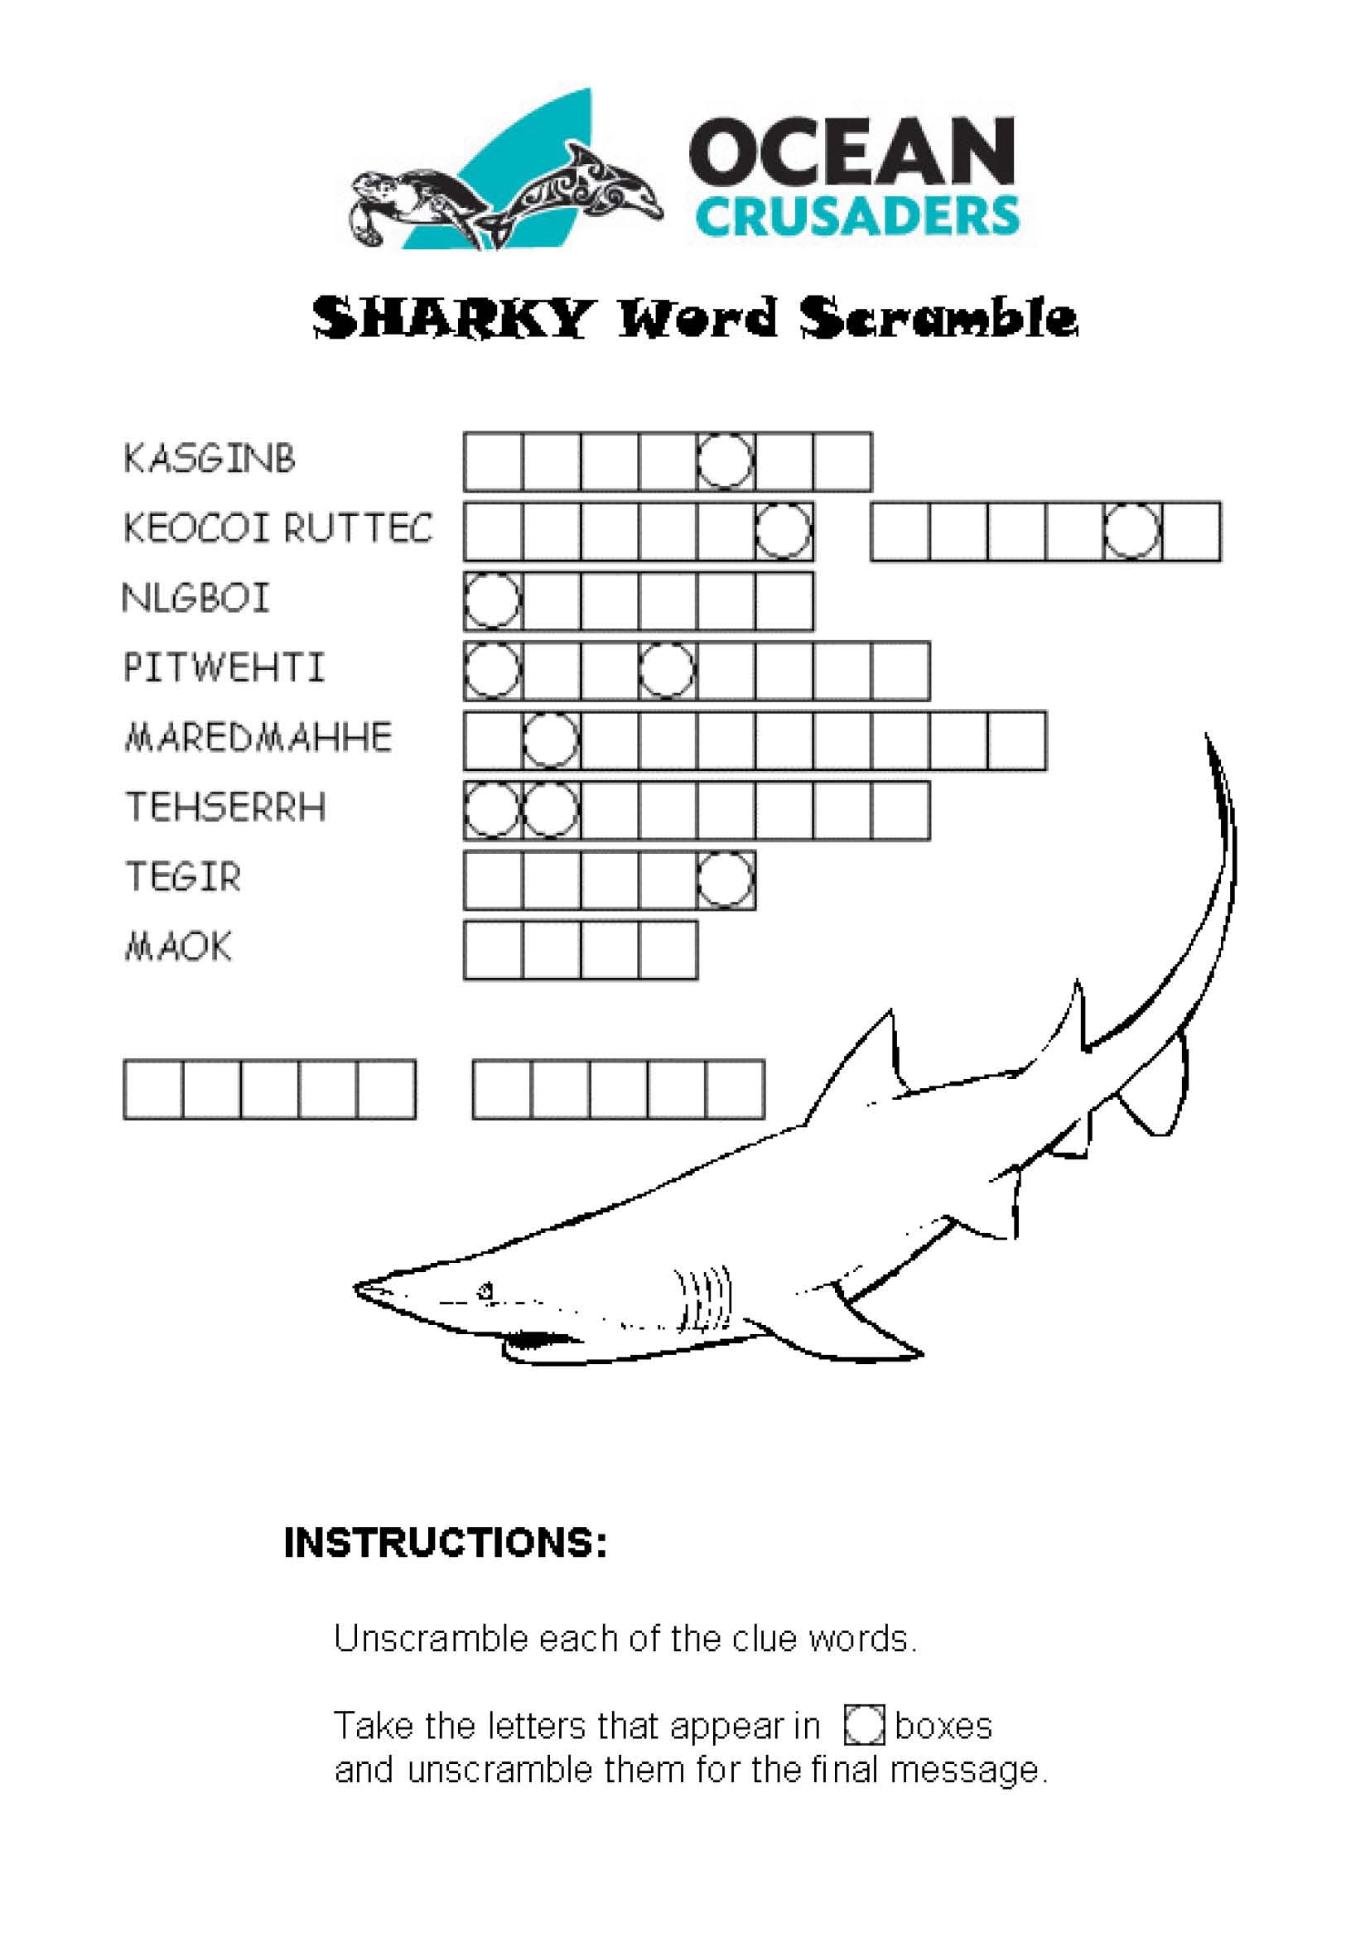
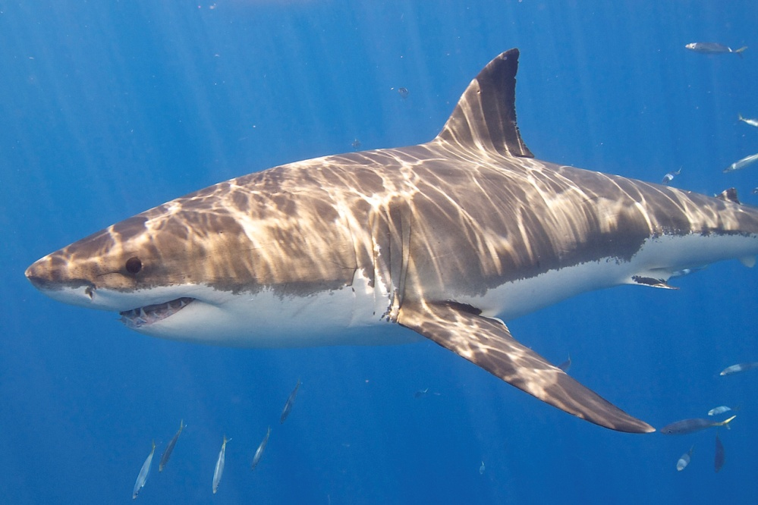
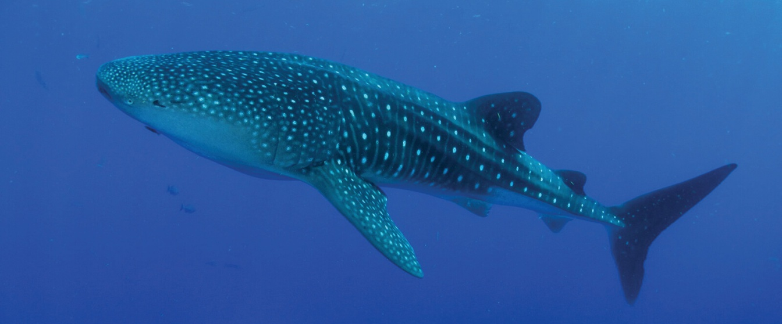
The Great White Shark is
one of the ocean’s
great predators; the world’s
largest shark, the Whale
shark, is a gentle giant and
feeds only on plankton and
small marine creatures
Great White Shark NOAA
Elias Levy, Creative Commons 2.0
Whale Shark Ryan Eckert/NOAA

Slide 14
