Slide 1
June 5 – Deepwater Horizon Oil Spill Disaster

Slide 2
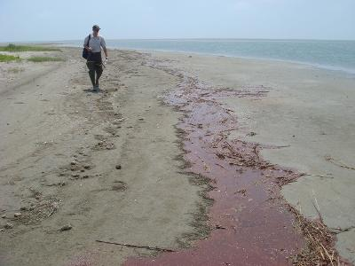
Reflections on the Oil Spill
The Deepwater Horizon oil spill began on April 20, 2010 with a blowout of BP's Macondo drilling platform and the tragic death of 11 men; 17 were injured
The current COVID 19 pandemic is a reminder that disaster can occur at anytime; Perdido Key residents are familiar with hurricane caused devastation; 2004’s Hurricane Ivan is well remembered by many and the foundations of swept away buildings are still visible along Perdido Key Drive; many are still recovering from 2020’s Hurricane Sally
But 2010’s Deepwater Horizon oil spill seemed different; it did not damage buildings or take away life on the coast per se, though it took a huge bite out of the local economy; perhaps the long duration of the oil blowout, 87 days and not knowing when it would end or what the long term effects would be had a different psychological effect from past calamities
One the best things that happened in that awful period was Jimmy Buffet’s July 11 free concert in Gulf Shores to help the local tourism industry and raised community spirits (the concert is available at https://www.youtube.com/watch?v=w_lxqJaPmhA
When the oil-gushing well was finally sealed on September 19, 2010, cleanup efforts continued on land and sea and researchers moved on with their work to determine the effects all that oil would have on the Gulf of Mexico and its coastal borders
NOAA Photo

Slide 4
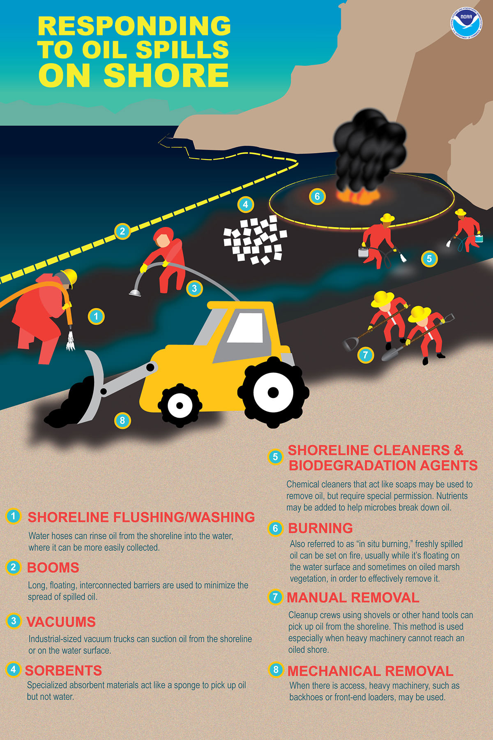
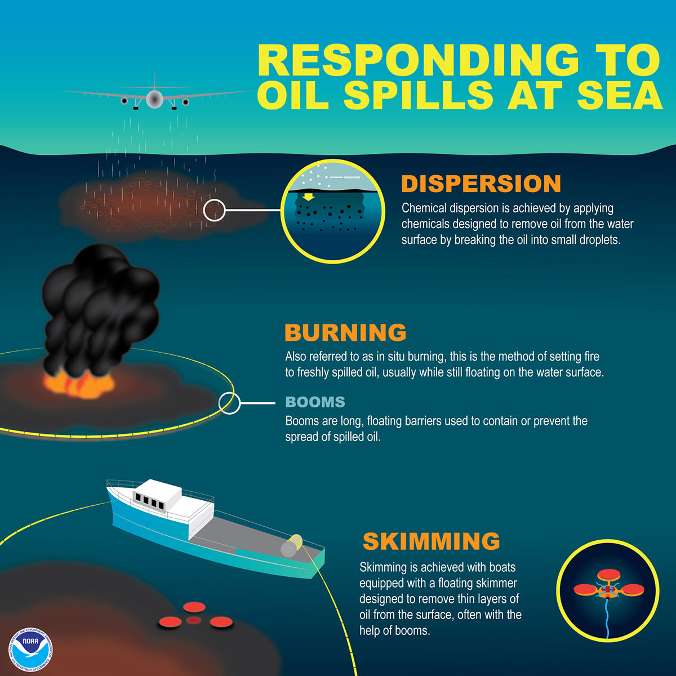

Slide 5
“Shining Light” on the Oil Spill
On December 4, 2019, the Pensacola Library hosted presentations put together by the Sea Grant Oil Spill Outreach Team on the lasting effects of the Deepwater Horizon disaster, called “Shining light on Deepwater Horizon’s impacts to the Florida Panhandle”
The June 5 and June 6 2020 World Oceans Day postings feature these scholarly presentations from a variety of disciplines; follow the links to videos of the presentations and relevant Sea Grant Fact Sheets
The “Shining Light” presentation can be found at https://gulfseagrant.org/oilspilloutreach/presentations/shining-light-on-deepwater-horizon-impacts-to-the-florida-panhandle/
Several of the following slides have links to the above mentioned presentation; if the link does not work, please copy the web location to Google or other search engine to access the video presentations
NOAA Infographic

Slide 6
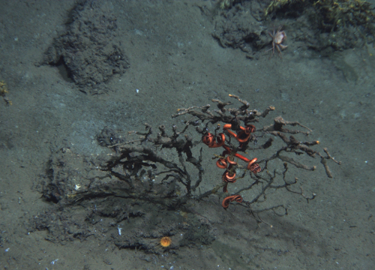
Marcus Huettel on Buried Oil Degradation on Pensacola Beach
Dr. Markus Huettel is a coastal oceanographer and member of the Department of Earth, Ocean and Atmospheric Science at Florida State University
View Dr. Huettel’s presentation at https://www.youtube.com/watch?time_continue=31&v=p3XuK1_YuKA&feature=emb_logo
See also “WHERE DID THE OIL GO? A DEEPWATER HORIZON FACT SHEET” at http://masgc.org/oilscience/where.did.oil.go.factsheet.pdf
Oil-Coated Deep Sea Coral, White et al./NOAA

Slide 7
Buried Oil Decomposition
Dr. Huettel explained that our area’s beaches were conducive to relatively rapid decomposition of oil from the spill because the nearly pure quartz sand provided substantial surface area for bacteria to thrive and breakdown the oil into CO2 and H2O
The area’s warm temperatures and moist air provided a climate in which bacteria could thrive, further aiding oil decomposition
Tidal actions essentially allowed the beaches to breath, taking in fresh air with oxygen for the bacteria with outgoing tides and expelling CO2 from the bacterial process with incoming tides
Oil residue from the Deepwater Horizon spill was essentially gone within one year though larger tar balls could remain for decades
NOAA Photo

Slide 8
Dolphin Swimming in Gulf Oil Slicks NOAA Photo

Slide 9
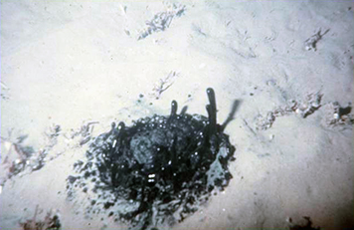
Richard Snyder on “Where did the oil go?”
Dr. Richard A, Snyder is a professor and director of the Virginia Institute of Marine Science Eastern Shore Laboratory, part of the College of William & Mary
https://www.youtube.com/watch?time_continue=6&v=KxECIB-auD0&feature=emb_logo
Fact Sheet: “FREQUENTLY ASKED QUESTIONS: DISPERSANT EDITION” at http://masgc.org/oilscience/oil-science-dispersants-fact-sheet.pdf
Natural Oil Seep Alan A. Allen/NOAA

Slide 10
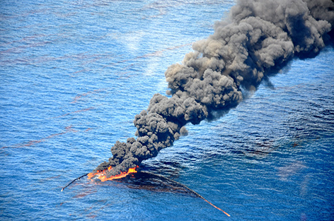
Where did the Oil Go?
Professor Snyder noted that oil from the Gulf of Mexico was known to Native Americans and Spanish settlers; oil naturally bubbles up from the floor of the Gulf through seeps but in quantities easily taken care of by bacteria; the Deepwater Horizon spill was overwhelming
Oil is complex with some portions evaporating quickly, some being potentially toxic and other parts stable and durable with time – think of asphalt
Chemical dispersants attach to oil and water to form droplets that are more easily broken down by bacteria
In general, the research mentioned did not find long-term toxicity from the spill in the samples taken
Using Fire and a Containment Boom to destroy oil NOAA Photo

Slide 11
Removing and sifting oil-soaked sand on Pensacola Beach NOAA Photo

Slide 12
Green Sea Turtle swimming over coral Kydd Pollock/US Fish and Wildlife Service

Slide 13
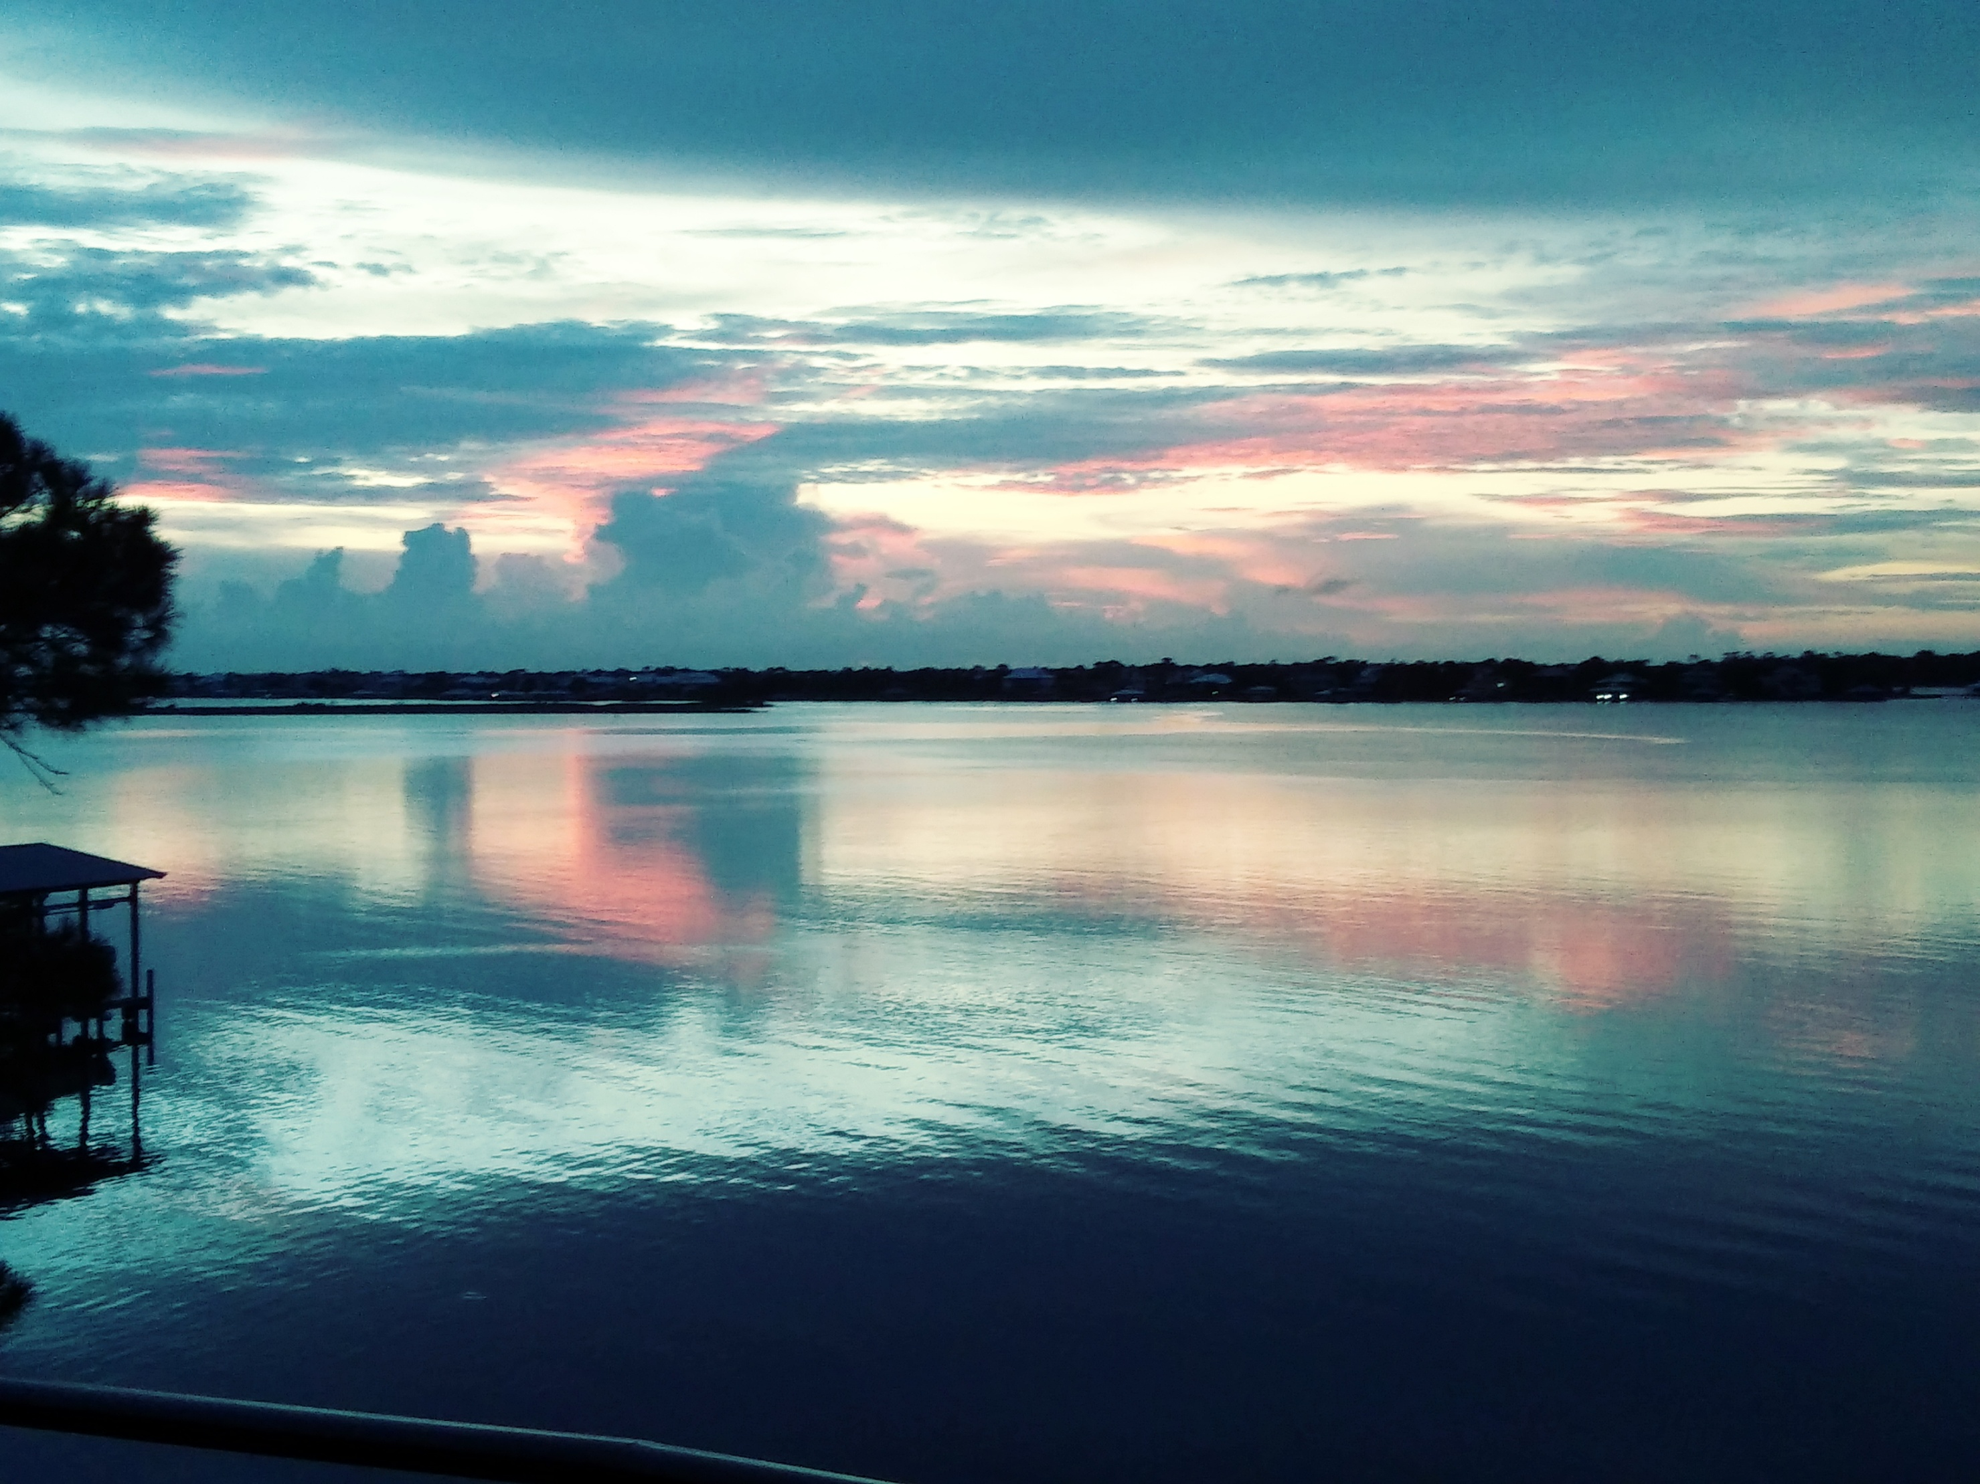
Perdido Key Sunset

